Slide 1


An Introduction to Community Health Workers
Health Action 2017
Ellen Albritton
Senior Policy Analyst
@EllenAlbritton

Slide 2
Who are Community Health Workers?
Trusted members of their community
Bridge between health care system, social services, and their community
Promotores
Lay Health Worker
Peer Educator
Peer Health Advisor
Community Health Representative
Community Health Aide
Lay Health Advisor
Patient Navigator
Health Educator
Peer Health Worker

Slide 3
What do Community Health Workers do?
Lead health education classes to help people prevent or better manage health conditions
Make home visits to provide more individualized attention or to conduct an environmental assessment
Help clients enroll in health insurance and social service programs
Coordinate care for people with complex health care needs
Advocate at the community level to improve the quality of housing, or bring needed resources to the community.

Slide 4
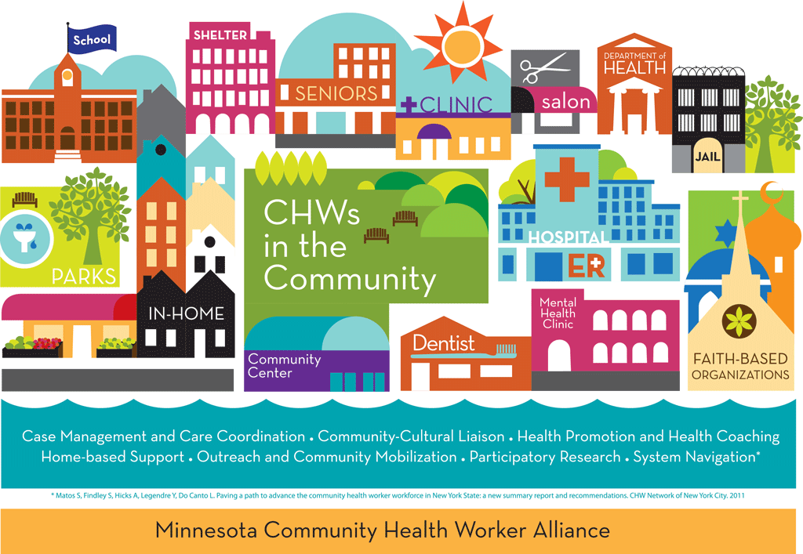
http://successwithchws.org/mental-health/wp-content/uploads/sites/2/2015/02/chwscommunity.png

Slide 5
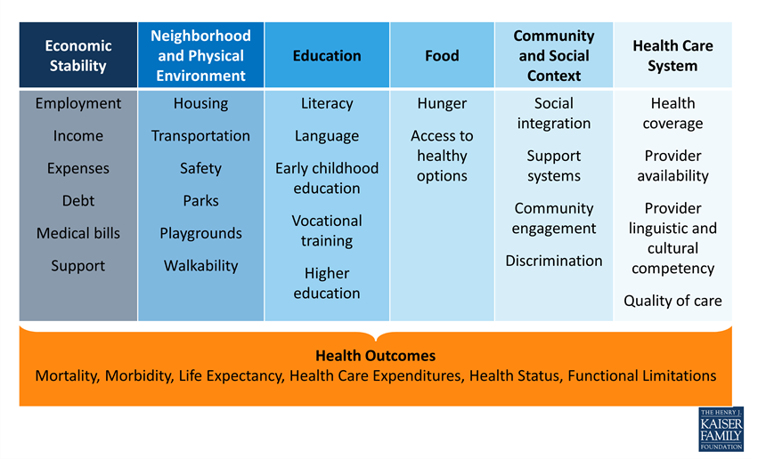
The Social Determinants of Health

Slide 6
CHWs Can Improve Health and Reduce Costs
Preventive services: Increased uptake of mammograms, Pap smears, colonoscopies, and vaccines
Diabetes: improved HbA1c levels
Asthma: reduced hospital admissions, less need for urgent care, fewer days with symptoms & fewer activity limitations
Cardiovascular disease: lower blood pressure
HIV/AIDS: More likely to have viral loads “under control”
The Institute for Clinical and Economic Review. (2013). Community Health Workers: A Review of Program Evolution, Evidence on Effectiveness and Value, and Status of Workforce Development in New England. https://icer-review.org/topic/community-health-workers/.

Slide 7
Funding for Community Health Workers
Grants—public & private
Operating budgets
Medicaid…
  Abby Charles, Institute for Public Health Innovation
  Gail Hirsch, MA Department of Public Health
  Charlie Alfero, Southwest Center for Health Innovation

