Slide 1
Addressing Race Equity Through Adverse Childhood Experiences (ACEs)
Aditi Srivastav, PhD, MPH
Director of Research
@aditisrivastav

Slide 2
Be part of the conversation
@ChildrensTrustSC
@childrenstrusts
@childrenstrustsc
Notes:
Children’s Trust of South Carolina is an intermediary organization that works to build strong communities and systems to prevent child abuse and neglect. I encourage you all to connect with us, and share your thoughts about our presentation today.

Slide 3
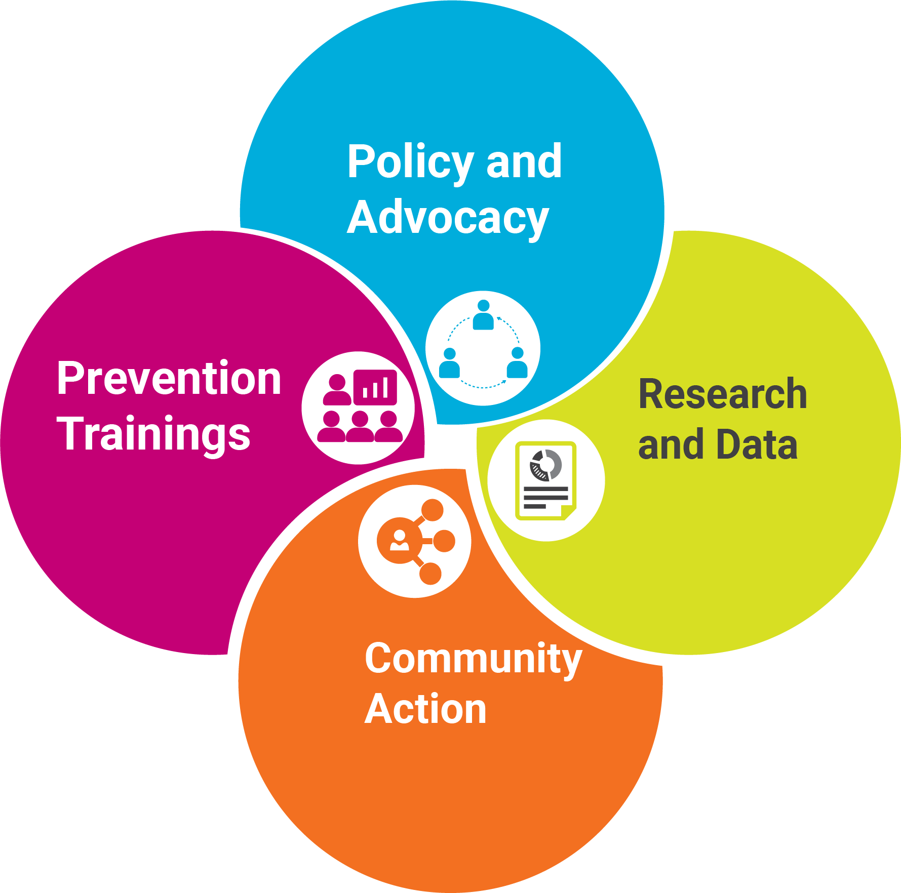
South Carolina
Adverse
Childhood Experiences (ACEs) Initiative
Notes:
The South Carolina ACE Initiative has four major areas of work. We conduct research on ACEs, collect ACEs and related data such as positive childhood experiences, and work to build capacity of communities to make data-driven decision making. We also help cultivate community action through community coalition building. We lead prevention trainings across the state on topics like ACEs and protective factors, and we help inform policy and advocacy through ACEs research, data, and relationship building. Today, I’ll be focusing on two aspects of our work, Research and Data and Community Action.

Slide 4
1
Adverse Childhood Experiences (ACEs) vs. Childhood Trauma
Key Terms
2
Race Equity vs. Structural Racism
3
Protective Factors & Resilience
Srivastav A., Spencer M., Strompolis M., Thrasher J.F., Crouch E., Davis R.E. (2019) Addressing health and well-being through state policy: understanding barriers and opportunities for policy-making to prevent Adverse Childhood Experiences (ACEs) in South Carolina. American Journal of Health Promotion. https://doi.org/10.1177/0890117119878068
Notes:
ACEs vs. Childhood Trauma: We think of trauma as more of a treatment term, as its used in phrases like trauma informed. Policymakers also find that ACEs are more relatable, as they can connect these experiences within their district. Trauma seems more acute and dramatic.
Race equity is the strengths based term for structural racism, recognizing that equity means intentional change in policies and practices, and not just interpersonal dynamics, although that is a major part. In my work, I explicitly call out the term race before equity, because research shows that often times, race gets ignored unless it is intentionally named in the work.
Finally, I conceptualize protective factors as the multi-level factors and contexts that must be in place to promote resilience, or the ability to thrive despite adverse experiences.

Slide 5
Social Determinants of health
Built Environment
Health and Wellness
Social and Community Context
Economic Stability
Education
Social Supports and network
ACEs
Srivastav, A., Fairbrother, G., & Simpson, L. A. (2017). Addressing Adverse Childhood Experiences through the Affordable Care Act: Promising advances and missed opportunities. Academic Pediatrics, 17(7S), S136–S143. https://doi.org/10.1016/j.acap.2017.04.007
Notes:
The original ACE study, which was conducted over 35 years ago, has just recently garnered momentum in public health and health care. As we think about its implications for addressing structural racism, we have to think about the parallels between ACE and social determinants of health. One of the key findings of the research around ACEs is that it serves as a frame for social determinants of health, suggesting that experiences in childhood are affected by a range of socio-environmental factors, which can change the trajectory of an individual’s life. In health care, as more efforts have been made to explicitly address the social determinants of health, I challenge you to think about how ACEs in particular can be addressed.

Slide 6
Original ACEs
Household Dysfunction
Domestic violence
Abuse
Physical
Incarceration of a parent
Mental illness in the household
Substance use in the household
Parent divorce/separation
Emotional
Sexual
Neglect
Emotional
Physical
Notes:
In the CDC-Kaiser ACE study, ten types of ACEs were conceptualized, covering experiences related to abuse, neglect, and household dysfunction. These ACE types went on to become the foundation of measuring childhood adversity in many public health efforts. Participants were asked yes no questions about these experiences. An example of a question is: Did you live with anyone who was a problem drinker or alcoholic? The number of yes’s = their ACE score. It should be noted that these scores simply indicated whether the experience occurred, not how severe or frequent the experiences were.

Slide 7
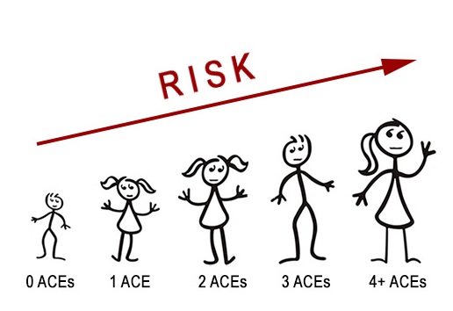
Key Findings of The CDC-Kaiser ACE Study
ACEs are common (63% )
ACEs are interrelated (87%)
ACEs have a dose-response relationship with health and social outcomes:
heart disease, asthma, obesity, unhealthy sexual behavior, smoking, alcohol use, substance use, mental illness, health care access, and overall productivity²
Notes:
Keeping in mind the population of the study. The results were striking.
Almost two-thirds (63%) of study participants reported at least one ACE, and more than one in five reported three or more ACEs.
Perhaps most importantly, the study revealed a “dose-response” relationship between ACEs and health problems, this meant that the higher your ACE score, the higher the likelihood of health problems. For example, individuals who reported ACEs are twice likely to be smokers, seven times more likely to abuse alcohol compared to their counterparts that reported no ACEs.

Slide 8
ACEs in their original form, do not promote racial equity
Focused on individual experiences without context
Most prevention and intervention efforts do not account for racial inequities that may increase exposure to trauma
Major focus on inherent & interpersonal relationships for resilience
Notes:
There is no doubt that the original ACE study, in which 10 experiences of abuse, neglect, and househould dysfunction were connected to multiple health and social outcomes later in life, was instrumental in changing the way we think about public health. Since that study there have been several subsequent research efforts that reinforce that ACEs are common across different populations, they are likely to co-occur, and they should be considered a root cause of risk behaviors which lead to poor outcomes in adulthood. This research has been crucial in garnering support for ACEs by practitioners and policymakers, highlighting that ACEs can happen to anyone. It’s this message that we have to keep in mind throughout our work with ACEs, while balancing the real challenge that ACEs, in their original form, do not promote racial equity. First and foremost, the original ACEs focus only on what happens in the home, rarely considering the contexts by which these experiences might happen. For example, parental incarceration is an ACE, and it has rarely been discussed within the context of mass incarceration. Additionally, the majority of prevention and intervention efforts discussed in the literature do not account for racial inequities in accessing services or interacting in with environments that are positive. Similarly, the majority of the evidence base for resilience has focused on self efficacy and self worth, and interpersonal relationships such as safe stable nurturing relationships, which don’t keep inequitable contexts in mind.

Slide 9
Early
Death
Adverse Childhood Experiences
Disease, Disability and Social Problems
Adoption of Health Risk Behaviors
Social, Emotional and Cognitive Impairment
Disrupted neurodevelopment
Historical Trauma & Structural Racism
DEATH
CONCEPTION
Source: RYSE Center, 2016
Notes:
And so, many researchers and advocates are beginning to argue that there is another layer to the ACE pyramid, which as you may know, served as the conceptual framework for the original ACE study. And while there is no doubt that this seminal study had an incredible impact on the way we think about health and well-being, it falls short of the whole picture, which is that we still see the effects of historical trauma and structural racism on exposure to ACEs, and we cannot ignore that this piece is likely a major piece in the puzzle of why health disparities continue to exist.

Slide 10
ACEs = Adverse Community Experiences?
Household Dysfunction
Domestic violence
Abuse
Physical
Incarceration of a parent
Mental illness in the household
Substance use in the household
Parent divorce/separation
Emotional
Sexual
Neglect
Emotional
Physical
Community Disadvantage
Neighborhood violence
Access to basic resources
Lack of economic mobility
Structural racism
Ellis, W. R., & Dietz, W. H. (2017). A new framework for addressing adverse childhood and community experiences: The building community resilience model. Academic Pediatrics, 17(7S), S86–S93. https://doi.org/10.1016/j.acap.2016.12.011
Notes:
Similarly, the field is moving towards reconceptualizing ACEs to include adverse community environments or experiences, to add the needed layer of context and emphasis on racial equity. My colleague Jeff, from the Building Community Resilience collaborative will be talking more about how this reconceptualization has helped further policy efforts to promote equity.

Slide 11
Resilience is broader than the individual
Positive Self-view
Safe, stable, nurturing relationships
Supportive Communities
Racially equitable policies, practices and systems
Srivastav, A., Fairbrother, G., & Simpson, L. A. (2017). Addressing Adverse Childhood Experiences through the Affordable Care Act: Promising advances and missed opportunities. Academic Pediatrics, 17(7S), S136–S143. https://doi.org/10.1016/j.acap.2017.04.007
Notes:
And an area that I’ll talk about today, is thinking about resilience has been broader than the individual. The protective factors that have been identified as key leaders in this space, such as the CDC, the Harvard Center for the Developing Child, Administration for Children and Families, etc., are summarized here, but they all have to be embedded within racially equitable policies, practices, and systems.

Slide 12
Race Equity and ACEs: Current Research and Practice Efforts
Notes:
So, next I’ll talk about some examples of my research in this space. With only a couple of minutes, I unfortunately will not be able to discuss it in depth, but I’m happy to talk offline in more detail.

Slide 13
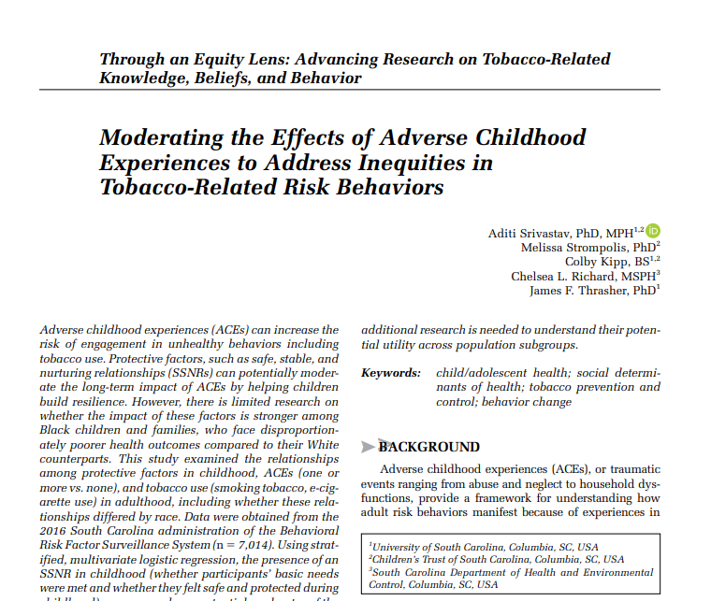
Examining
Race Equity, ACEs, and Risk Behaviors
South Carolina Behavioral Risk Factor Surveillance System (SC-BRFSS)
Cross-sectional, telephone-based survey
Non-incarcerated, adults 18 + that reside in South Carolina
Representative of state population
Self-report and retrospective about ACEs
Data from 2017 (n=7,014) on demographics, ACEs, and tobacco risk behaviors
Srivastav, A., Strompolis, M., Kipp, C., Richard, C. L., & Thrasher, J. F. (2020). Moderating the Effects of Adverse Childhood Experiences to Address Inequities in Tobacco-Related Risk Behaviors. Health Promotion Practice, 21(1_suppl), 139S-147S. https://doi.org/10.1177/1524839919882383
Notes:
Recently, I led a study examining the relationship between ACEs, tobacco use, the role of protective factors by race, using our statewide behavioral risk factor surveillance system data from 2017.

Slide 14
How do these differences compare by race?
Safe Stable Nurturing Relationships
-basic needs met
-safe and protected
Adverse Childhood Experiences (ACEs)
Risk Behaviors
-smoking
-e-cigarettes
Chronic Disease and Illness
Notes:
And so the goal was to understand how…

Slide 15
Adjusted odds ratios and 95% Wald confidence intervals estimates of the influence of protective factors on the association between Adverse Childhood Experiences (ACEs)¹ and smoking in adulthood by race
 | White Adults |  | Black Adults
Dependent Variable: Smoking Tobacco | ²Adjusted Odds Ratios Point Estimate 95% CI |  | ²Adjusted Odds Ratios Point Estimate 95% CI
SSNRs * ACEs
No ACEs * Yes SSNRs | REF | REF | REF | REF
Yes ACEs * No SSNRs | 2.26 | 1.49-3.43 | 1.53 | 0.70-3.33
Yes ACEs * Yes SSNRs | 1.53 | 1.20-1.94 | 1.80 | 1.14-2.83
¹one or more ACEs ² Adjusted for sex, age, education, and household income

Slide 16
Adjusted odds ratios and 95% Wald confidence intervals estimates of the influence of protective factors on the association between Adverse Childhood Experiences (ACEs) and smoking in adulthood by race
 | White Adults |  | Black Adults
Dependent Variable: E-Cigarette Use | ²Adjusted Odds Ratios Point Estimate 95% CI |  | ²Adjusted Odds Ratios Point Estimate 95% CI
SSNRs * ACEs
No ACEs * Yes SSNRs | REF | REF | REF | REF
Yes ACEs * No SSNRs | 4.21 | 2.22-7.98 | 2.25 | 0.50-10.08
Yes ACEs * Yes SSNRs | 2.95 | 1.88-4.62 | 1.56 | 0.53-4.63
¹one or more ACEs ² Adjusted for sex, age, education, and household income

Slide 17
Findings & Implications
Safe, Stable Nurturing Relationships significantly reduced the odds of smoking and e-cig use among White adults who reported ACEs, but not Black adults
Can’t promote safe, stable, nurturing relationships without thinking about the larger context of how relationships and environments are influenced
Highlights the need to reconceptualize ACEs to think about historical and community trauma
Speaks to the importance of seeing the impact of racism/addressing beyond interpersonal relationships, but in organizational practices, social norms, policies, and procedures
Notes:
The study’s results were unexpected by not surprising. SSNR’s significantly….

Slide 18
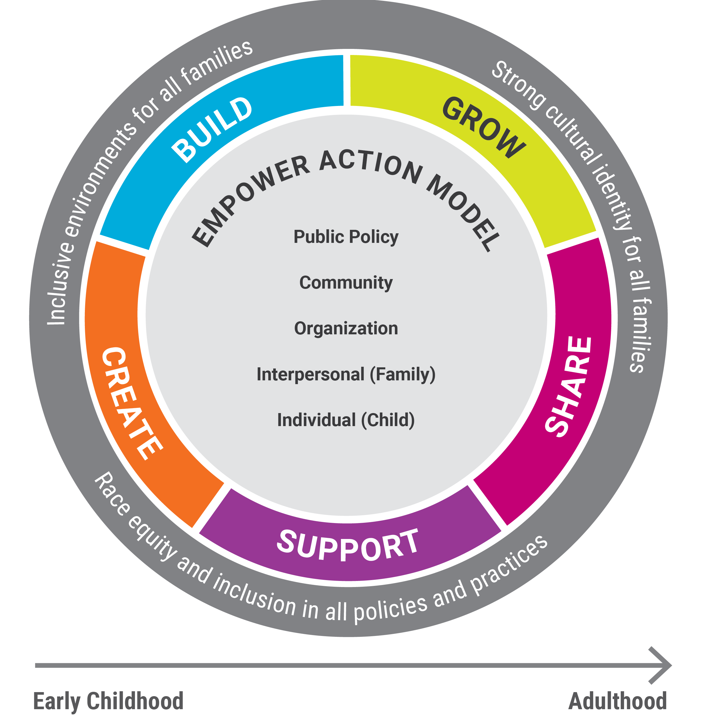
The Empower Action Model
Srivastav, A., Strompolis, M., Moseley, A., & Daniels, K. (2019). The Empower Action Model: A Framework for Preventing Adverse Childhood Experiences by Promoting Health, Equity, and Well-Being Across the Life Span. Health Promotion Practice. https://doi.org/10.1177/1524839919889355
Notes:
And then finally, on a more practical note, I recently led the effort of developing an evidence based model that can help communities, organizations, and policy advocates develop plans for action around ACEs and resilience. Bringing together key theories in public health and social justice, the Empower Action Model suggests that these five factors, which are framed in action terms:
Must be applied across multiple levels of influence, across the lifespan, and through the lense of race equity.

Slide 19
Notes:
What makes this model unique is that it goes beyond just presenting the key pieces needed to build equity, health, and well-being. More specifically, it provides the ideal conditions by each of these protective factors can be applied across multiple levels with race equity serving as its foundation. Now the process by which an organization or community gets to this ideal condition will vary, as we know there is no one size fits all approach. And that is intentional to ensure that the model is tailored to different needs and strengths.

Slide 20
How does the Empower Action Model Promote Race Equity?
The model engages users in an intentional planning process the considers the role of structural racism in the ways in which communities, organizations, and policies interact through coaching, facilitation, and technical assistance.

Slide 21
“Nothing that is worth doing can be achieved in our lifetime; therefore we must be saved by hope.”
-Reinhold Neibuhr
Notes:
So with all of that information, you may be feeling a little overwhelmed or anxious. I always like to end my presentations with this quote, because it reminds us that while this work may be slow, frustrating or sometimes make us feel hopeless, it is worth it.
Thanks so much, and I will pass it over to my colleague Jeff.

Slide 22
Thank you
Asrivastav@scchildren.org 803-744-4062

