Slide 1
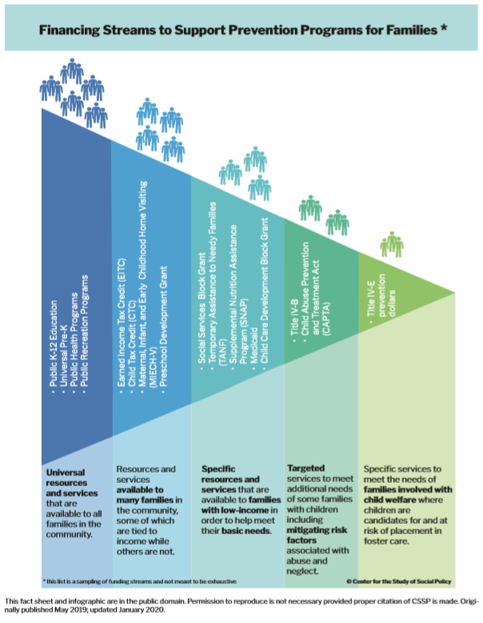
Financing Streams to Support Prevention Programs for Families
Notes:
We want to share this infographic which creates a visual for funding streams supporting families.
This is critical in thinking about how the title IV-E prevention plan and funding stream can fit into a broader prevention scope

