Slide 1
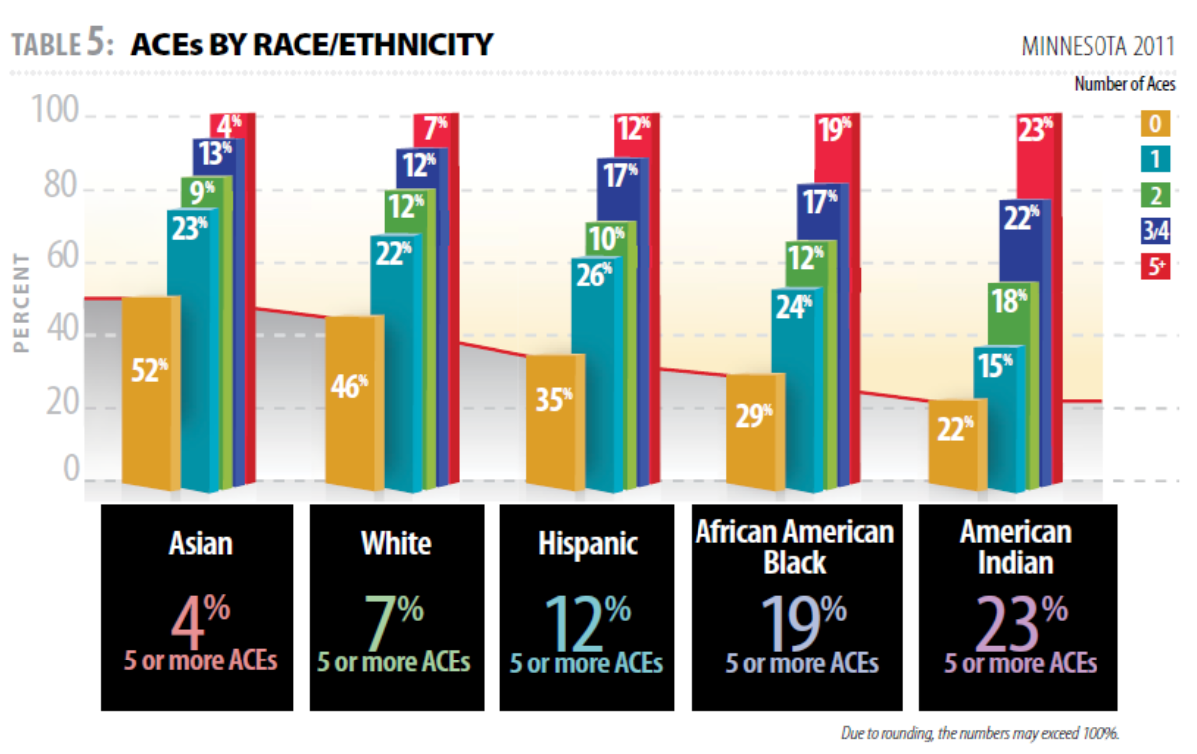

Slide 2
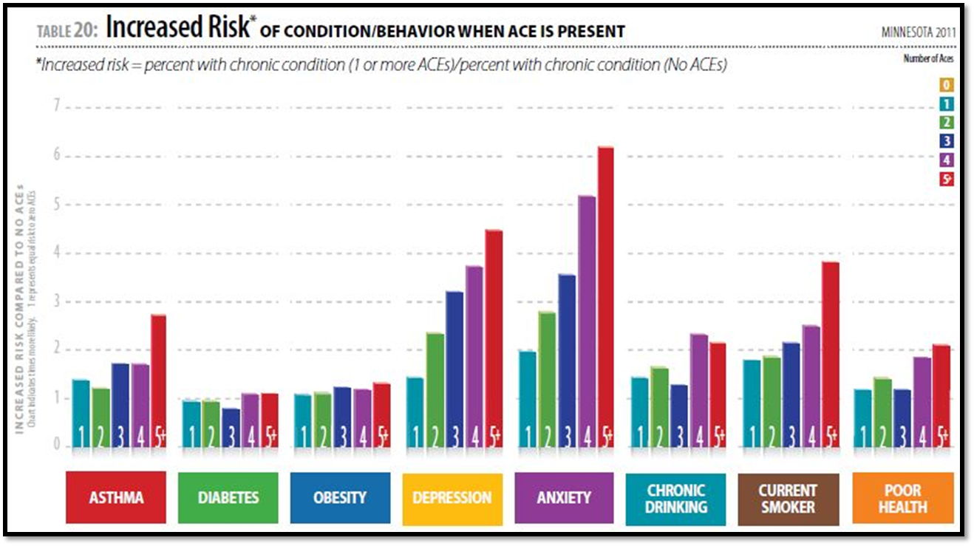

Slide 3
Key Takeaways - HEALTH
According to the Health Trends in Indian Health, 2014 Edition, the number of infant mortality rates have decreased from 1973 to 2008, however, Native American mortality rates remains higher than the rates for all races nationally
The two leading causes of AI/AN deaths (2007-2009) for ages 1 to 4 were unintentional injuries and homicide. Unintentional injury deaths were 3.9 times higher for AI/AN than U.S. all races and 4 times higher than U.S. white populations.
The IHS service population is increasing at an average rate of about 1.8 percent per year, excluding the impact of new Tribes. It is estimated to be approximately 2.1 million in CY 2014.
HEALTH DISPARITIES: Native people die at higher rates than other Americans from: tuberculosis: 600% higher - alcoholism: 510% higher - diabetes: 189% higher, vehicle crashes: 229% higher --injuries: 152% higher - suicide: 62% higher, Native youth have the highest rate of suicide among all ethnic groups in the US and is the second-leading cause of death for Native youth aged 15-24. (r4) (www.ncai.org)

Slide 4
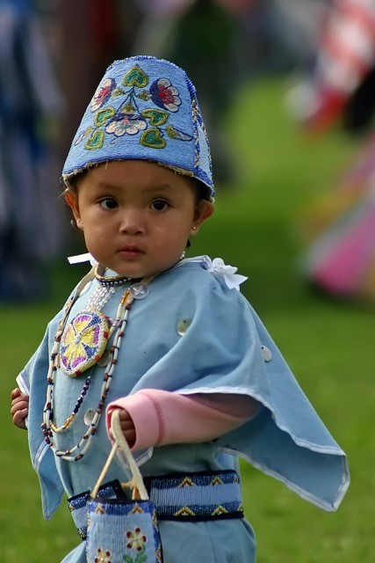
Key Takeaways – CHILD PROTECTION & FOSTER CARE
Rate of alleged victims in accepted CPS reports per 1,000 children (2015) Native American: 96.5 compared to White: 17.6
Rate of out-of-home placements per 1,000 children (2015) Native American: 104.5 compared to White: 6.2 (Minnesota DHS)
26.2% was the percentage of single-race American Indian and Alaska Native people who were in poverty in 2016, the highest rate of any race group. For the nation as a whole, the poverty rate was 14.0 percent. (Oct 6, 2017 www.census.gov)
About 32 percent of Natives are under the age of 18, compared to only 24% of the total population who are under the age of 18. The median age for American Indians and Alaska Natives on reservations is 26, compared to 37 for the entire nation. (www.ncai.org)

Slide 5
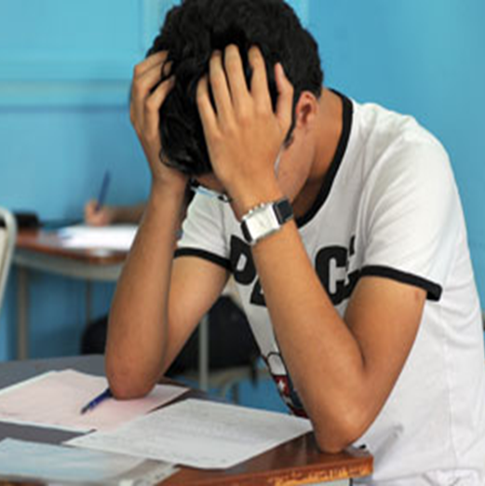
Key Takeaways - EDUCATION
Only five percent of American Indians and Alaska Natives have received graduate or professional degrees, compared to 10 percent for the total population, and only nine percent of American Indians have earned bachelor’s degrees compared to 19 percent for the US population. (r11) (www.ncai.org)
Today, native youth post the worst achievement scores and the lowest graduation rates of any student subgroup. Last school year 67 percent of American Indian students graduated from high school compared the national average of 80 percent. Native American Students Left Behind Native youth post the worst achievement scores and lowest graduation rates of any student subgroup.
More than 60% of U.S. high school students go on to college, while only 17% of American Indian students are able to continue their education after high school, facing a number of challenges the average student does not encounter. (Lauren Camera, Education Reporter |Nov. 6, 2015)

Slide 6
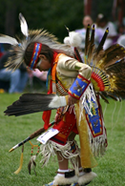
Promising Programs/Practices in Indian Country
Maternal Infant & Early Childhood Home Visiting Programs (only 25)
Indian Health Service (underfunded mandate)
Johnson O’Malley/B.I.E. schools (underfunded mandates)
Early Childhood Mental Health Services (limited service professionals)
Child Care Development Block Grant (increase 2018 – 40 new CC facilities)
Head Start/Early Head Start
Indian Child Welfare Act (the ability to keep children in their community/culture)
Increased collaborations between Tribes – States – Federal Government – Foundations (T.E.L.I, Tribal Consultations, Inclusion (not an after-thought) re: policies, laws, funding and consultations)
W.E.C.A.R.E Case Management & Data Collection (White Earth, MN)
Culture/language supports, resources and funding (ANA for example)
Bridges to Benefit – Help Me Grow – Help Me Connect: On-Line Access/Eligibility

