Slide 1
Surprise Billing in Colorado
January 23, 2020
Caitlin Westerson
Policy Director
cwesterson@cohealthinitiative.org

Slide 2
About Us
Mission & Vision
MISSION. CCHI advances the consumer voice to improve access to health care for all Coloradans by working statewide for progress toward equity, access, affordability, and quality.
VISION. All Coloradans have equitable access to affordable, high quality health care.
Notes:
Good afternoon, I appreciate the opportunity to be here today and give you a consumer perspective about surprise, or balance, billing.
Before I begin, just a bit about my organization, the Colorado Consumer Health Initiative. We are a state based non profit membership organization dedicated to ensuring equitable access to affordable and high quality coverage for all Coloradans. We also recently began running a consumer assistance program to help individuals navigate claims and billing issues – and as a result, we are hearing an awful lot about surprise bills.

Slide 3
Summary
Where is Colorado and how did we get here?
Overview of 2019 legislation
What did we learn?

Slide 4
Timeline
Brief history of balance billing in CO

Slide 5
Timeline
History of Surprise Billing in Colorado
1997
Network adequacy established
2019
Bill PASSED!
2006
2015
2016
2017
2018
First balance billing protections in place
Bill failed
Bill failed
Bill failed
Bill failed
Notes:
1997 network adequacy established
2006 first balance billing protections
2015/2016/2017/2018 failed attempts
2019 comprehensive balance billing protections passed
This is not a new issue for us in Colorado. Colorado passed a law several years ago to protect consumers when they seek services at an in network facility but end up being seen by an out of network provider. In that circumstance, the consumer is supposed to be responsible for their in network cost share for those services. However, in our experience, that protection hasn’t been working as well as we would have liked and so, for the past 4 years, we have been engaged in attempts at our state legislature to strengthen those protections. The first year or two, carriers brought the bill, then the doctors brought th bill and last year consumers brought it. . . and all failed. We are hoping for success in year 5

Slide 6
Timeline
History of Surprise Billing in Colorado
1997
Network adequacy established
2006
First balance billing protections in place
Not comprehensive
Many consumers still faced balance bills, especially in emergency situations
Notes:
1997 network adequacy established
2006 first balance billing protections
2015/2016/2017/2018 failed attempts
2019 comprehensive balance billing protections passed
This is not a new issue for us in Colorado. Colorado passed a law several years ago to protect consumers when they seek services at an in network facility but end up being seen by an out of network provider. In that circumstance, the consumer is supposed to be responsible for their in network cost share for those services. However, in our experience, that protection hasn’t been working as well as we would have liked and so, for the past 4 years, we have been engaged in attempts at our state legislature to strengthen those protections. The first year or two, carriers brought the bill, then the doctors brought th bill and last year consumers brought it. . . and all failed. We are hoping for success in year 5

Slide 7
What are “comprehensive protections”?
According to the Commonwealth Fund…
Protections for emergency services
Protections for non-emergency care at in network facilities
Applicable to managed care plans
Includes a hold harmless provision
Includes a prohibition on balance billing
There is a state-specific method for payment.
There is a payment standard in place.
There is a dispute-resolution process in place.
Notes:
Emergency department setting: The state must have protection in place for emergency services provided by nonnetwork providers at both in-network and out-of-network facilities. If there is a caveat, this will be noted in a footnote.
Nonemergency care in network hospital: The state must have protection in place for nonemergency care provided in a network facility.
Type of managed care plan: The state requirement must apply to these specific types of health plans.
Hold harmless protection: The state requirement must state that a consumer is held not liable financially for the any portion of the bill beyond in-network level cost-sharing.
Provider prohibition: The state requirement must state that a provider is prohibited from sending any balance bill to the patient for any amount beyond in-network level cost-sharing.
State-specific method for payment: In general, a state has either a payment standard or a dispute resolution process (unless the approach differs by setting, as in Florida). States with a payment standard also may have a voluntary dispute resolution process to deal with a failure of the payment standard. States with a dispute resolution process may have more general guidance on a payment standard for use by plans or by the arbitrator.
Payment standard: The state must provide a formula that the insurer must apply when determining how much to pay an out-of-network provider and the provider has to accept this amount.
Dispute-resolution process: The state must require binding arbitration between the insurer and provider to determine an amount. Any direction by the state on how the arbitrator must decide the dollar value is added as a footnote.

Slide 8
What are “comprehensive protections”?
Colorado had…
Protections for emergency services
Protections for non-emergency care at in network facilities
Applicable to managed care plans
Includes a hold harmless provision
Includes a prohibition on balance billing
There is a state-specific method for payment.
There is a payment standard in place.
There is a dispute-resolution process in place.
Notes:
Emergency department setting: The state must have protection in place for emergency services provided by nonnetwork providers at both in-network and out-of-network facilities. If there is a caveat, this will be noted in a footnote.
Nonemergency care in network hospital: The state must have protection in place for nonemergency care provided in a network facility.
Type of managed care plan: The state requirement must apply to these specific types of health plans.
Hold harmless protection: The state requirement must state that a consumer is held not liable financially for the any portion of the bill beyond in-network level cost-sharing.
Provider prohibition: The state requirement must state that a provider is prohibited from sending any balance bill to the patient for any amount beyond in-network level cost-sharing.
State-specific method for payment: In general, a state has either a payment standard or a dispute resolution process (unless the approach differs by setting, as in Florida). States with a payment standard also may have a voluntary dispute resolution process to deal with a failure of the payment standard. States with a dispute resolution process may have more general guidance on a payment standard for use by plans or by the arbitrator.
Payment standard: The state must provide a formula that the insurer must apply when determining how much to pay an out-of-network provider and the provider has to accept this amount.
Dispute-resolution process: The state must require binding arbitration between the insurer and provider to determine an amount. Any direction by the state on how the arbitrator must decide the dollar value is added as a footnote.

Slide 9
Timeline
History of Surprise Billing in Colorado
2015
2016
2017
2018
Bill failed
Bill failed
Bill failed
Bill failed
No industry partnerships
Proposals did not include comprehensive protections
Notes:
1997 network adequacy established
2006 first balance billing protections
2015/2016/2017/2018 failed attempts
2019 comprehensive balance billing protections passed
This is not a new issue for us in Colorado. Colorado passed a law several years ago to protect consumers when they seek services at an in network facility but end up being seen by an out of network provider. In that circumstance, the consumer is supposed to be responsible for their in network cost share for those services. However, in our experience, that protection hasn’t been working as well as we would have liked and so, for the past 4 years, we have been engaged in attempts at our state legislature to strengthen those protections. The first year or two, carriers brought the bill, then the doctors brought th bill and last year consumers brought it. . . and all failed. We are hoping for success in year 5

Slide 10
Timeline
History of Surprise Billing in Colorado
Strong industry partnerships
Proposal included comprehensive consumer protections
LOTS of stakeholder engagement
Legislator education
2019
Bill PASSED!
Notes:
1997 network adequacy established
2006 first balance billing protections
2015/2016/2017/2018 failed attempts
2019 comprehensive balance billing protections passed
This is not a new issue for us in Colorado. Colorado passed a law several years ago to protect consumers when they seek services at an in network facility but end up being seen by an out of network provider. In that circumstance, the consumer is supposed to be responsible for their in network cost share for those services. However, in our experience, that protection hasn’t been working as well as we would have liked and so, for the past 4 years, we have been engaged in attempts at our state legislature to strengthen those protections. The first year or two, carriers brought the bill, then the doctors brought th bill and last year consumers brought it. . . and all failed. We are hoping for success in year 5

Slide 11
Overview of HB19-1174

Slide 12
HB19-1174
When does it apply?

Slide 13
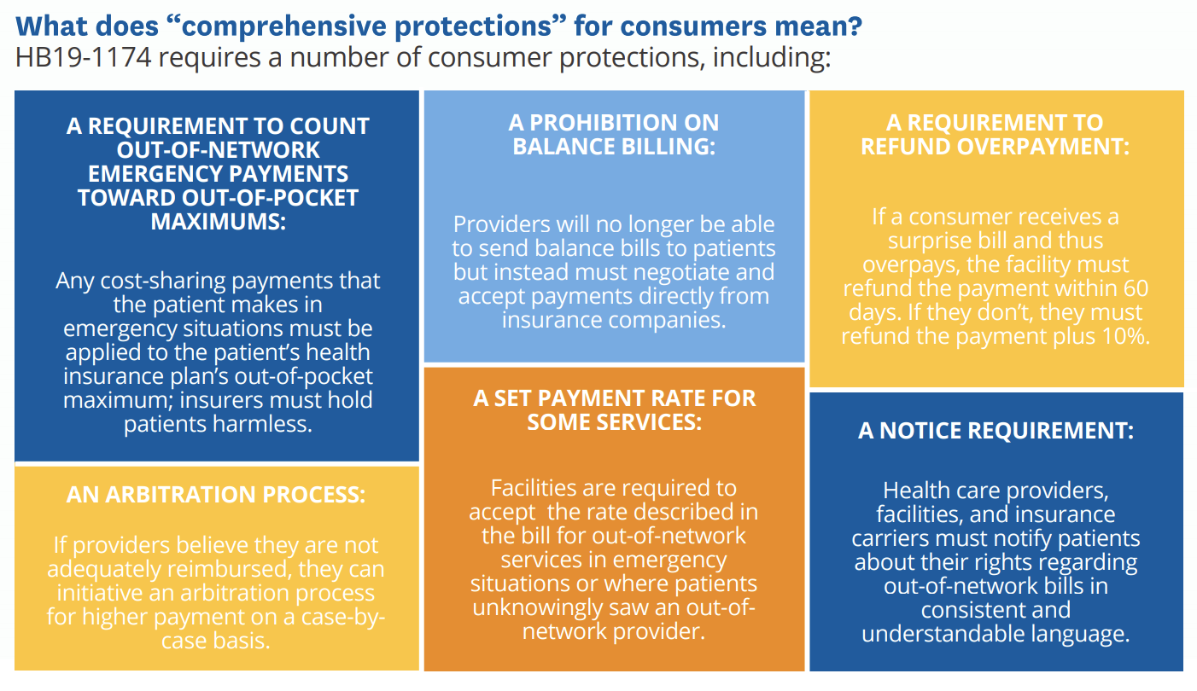
HB19-1174
What does it do?

Slide 14
HB19-1174
What’s the payment rate?
PROVIDERS
FACILITIES
Greater of…
110% of the carrier’s median in-network rate for the same service in the same geographic area; or
The 60th percentile of the in-network rate for the same service in the same geographic area based on claims from the Colorado All Payers Claims Database in the prior year
Greater of…
105% of the carrier’s median in-network rate for the same service in the same geographic area; or
The median (50th percentile) in-network rate for the same service in the same geographic area based on claims from the Colorado All Payer Claims Database in the prior year

Slide 15
HB19-1174
Are ambulances included?
The Division of Insurance was required to “identify and implement a payment methodology” for some out-of-network ambulances; publicly-funded, fire-based ambulance providers were excluded.
The DOI set the payment rate for ambulances at 275% of Medicare (+mileage), with a prohibition on balance billing, and guardrails for certain contractual relationships.

Slide 16
Lessons Learned
Notes:
We learned lots of lessons—these are the two biggest takeaways

Slide 17
Who are your partners?
Because you’re going to need them!
Build a robust coalition. Health insurance companies can be helpful:
Data and egregious examples
Chamber & business partnerships
Resources (posters & lobbying)
Know where your lines in the sand are. Transparent with bill sponsors and partners about sticking points:
Notice/disclosures to consumers (CCHI)
Prohibition on balance billing (CCHI)
Payment rate, not based on billed charges (CAHP)

Slide 18
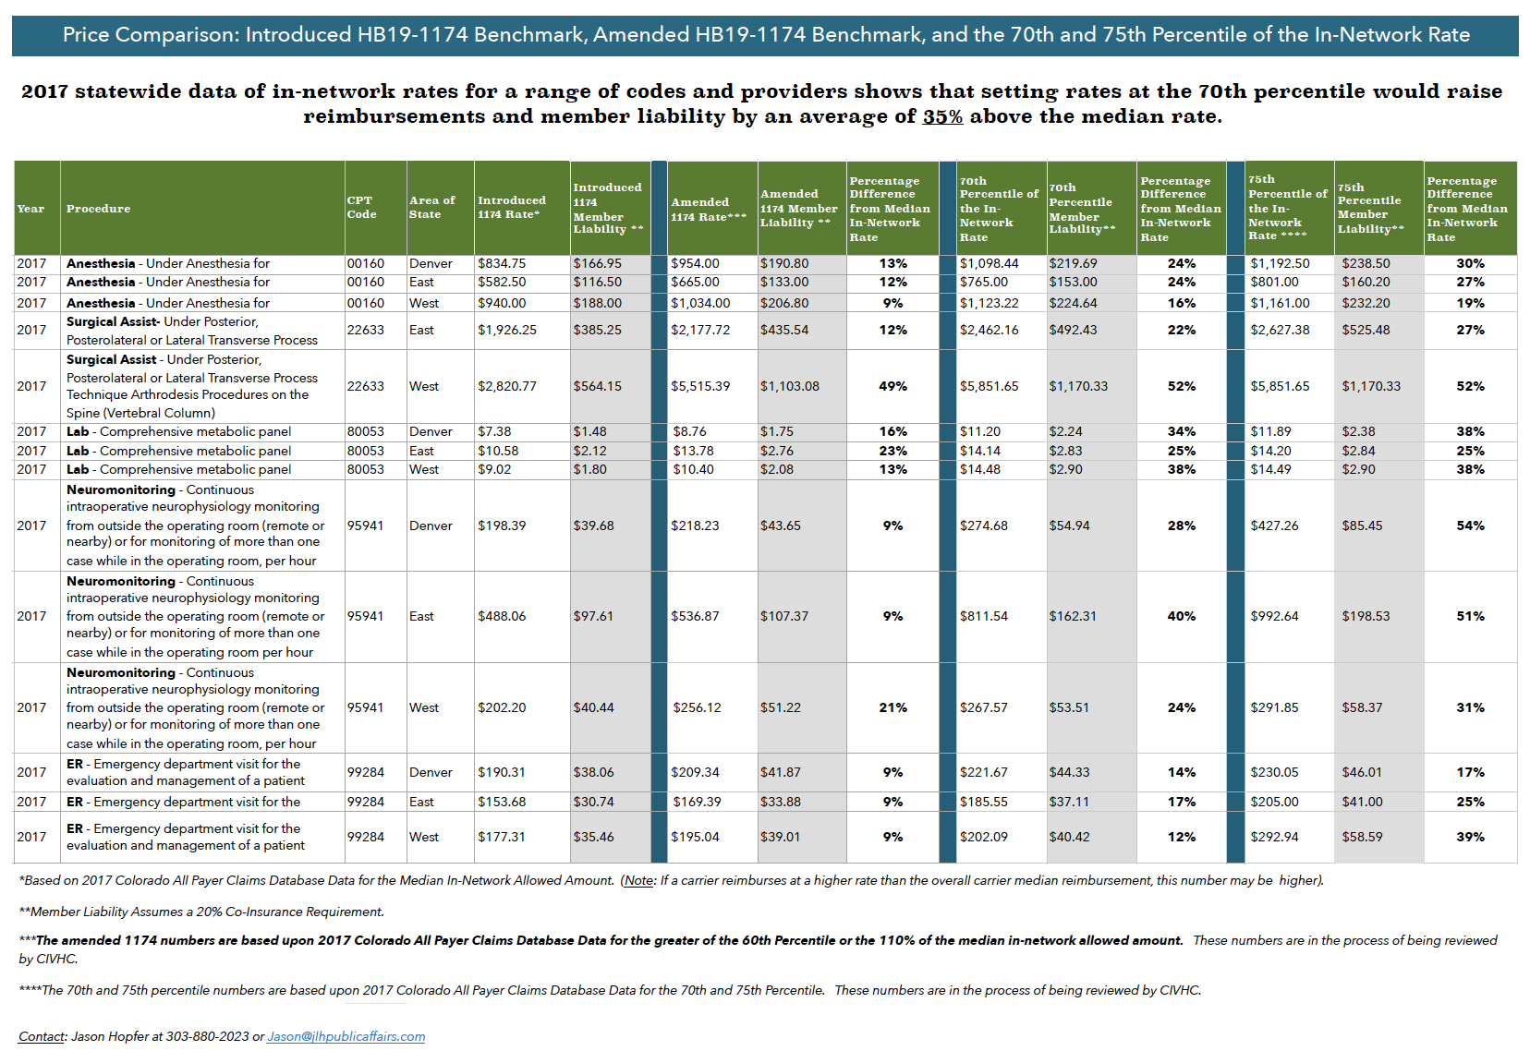
Member liability in introduced vs. proposed amendments

Slide 19
Implementation
Make friends with your regulatory agencies!
Arbitration
Ambulance payment rate
Carrier disclosures requirements (for patients)
Payment rates for facilities and providers
Reporting requirements for carriers
Facility disclosure requirements (for patients)
Provider disclosure requirements (for patients)
DOI
CDPHE
DPO
Notes:
Challenges:
--insufficient data and what to do about it
--consumer notice—intention to sign?

Slide 20
Thank you!

