Slide 1
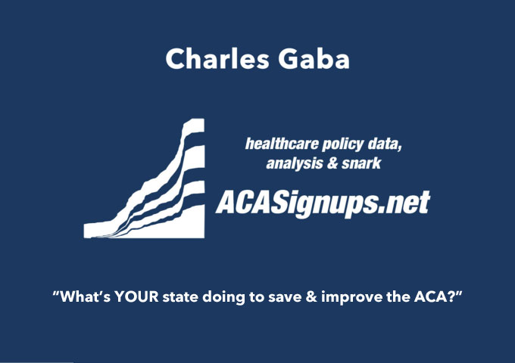

Slide 2
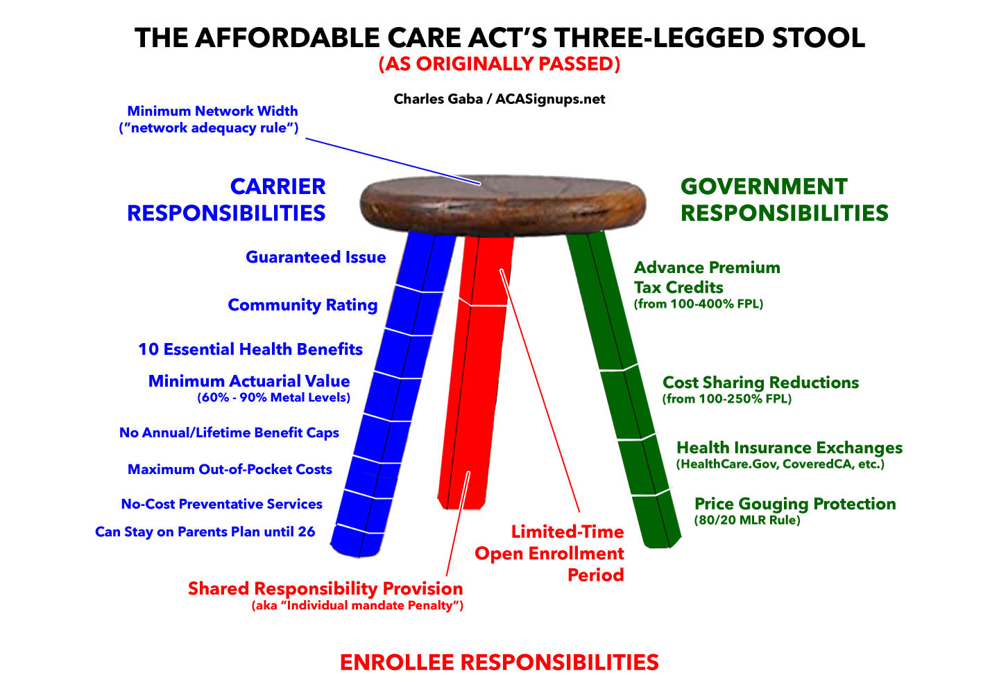

Slide 3
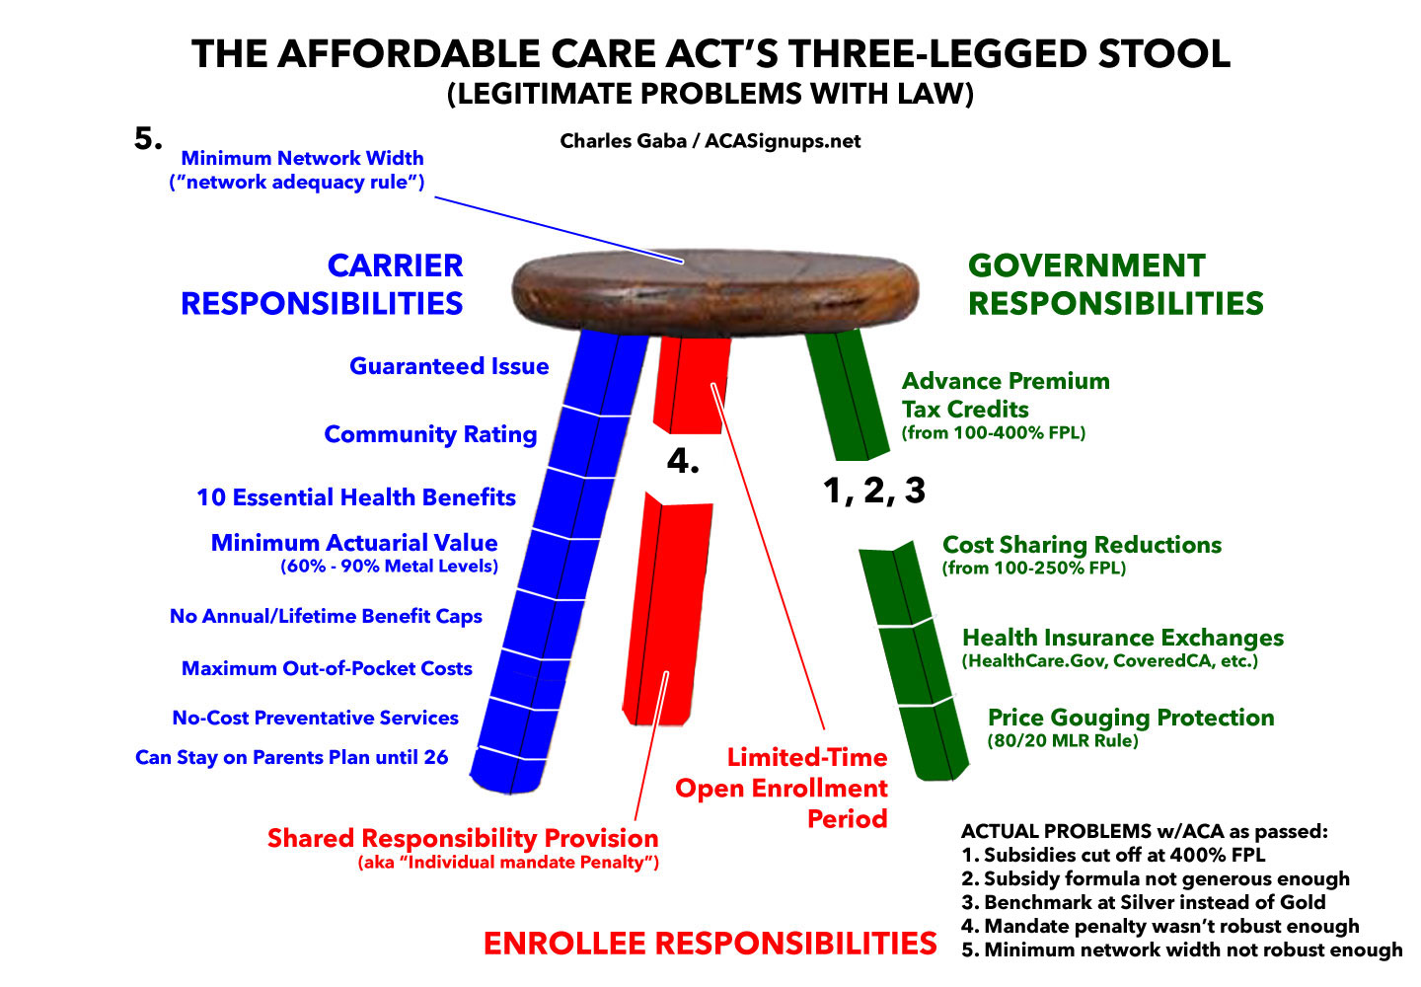

Slide 4
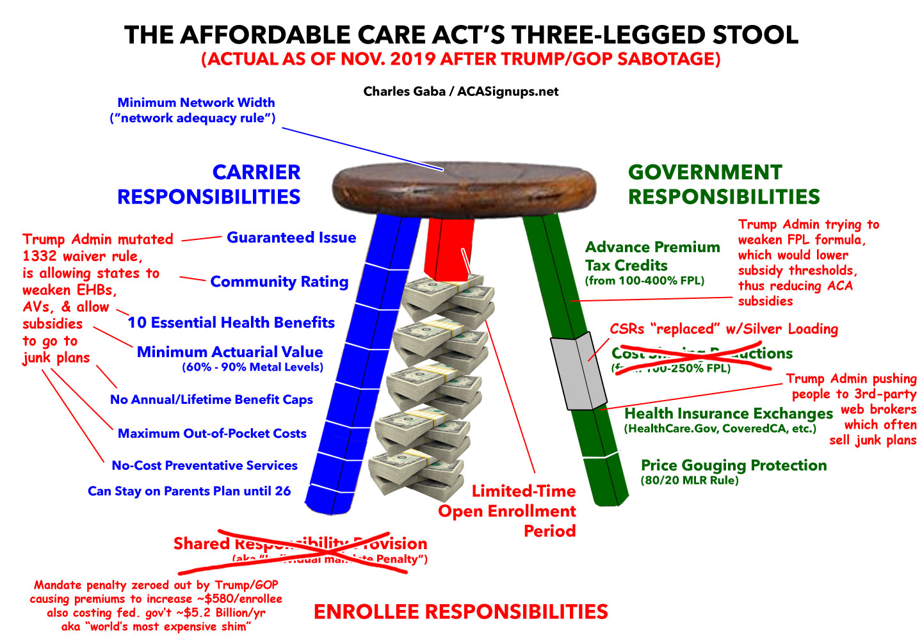

Slide 6
“Blue Leg” Protections:
Guaranteed Issue
Community Rating
10 Essential Health Benefits
Minimum 60% AV Rating
No Annual / Lifetime Coverage Limits
Maximum Out-of-Pocket Limit
No-Cost Preventative Services
Children stay on parents plan until 26
3:1 or Lower Age Band
50% or Lower Smoker Surcharge

Slide 7
“Red Leg” Protections:
Reinstate Individual Mandate Penalty
California (2020)
District of Columbia (2019)
Massachusetts (2019)
New Jersey (2019)
Rhode Island (2020)
Vermont (no actual penalty)
Extended/Custom Open Enrollment Period
California (3 months)
Colorado (76 days)
Connecticut (76 days)
District of Columbia (3 months)
Massachusetts (84 days)
Minnesota (53 days)
New York (3 months)
Rhode Island (61 days)
Washington State (60 days)

Slide 8
“Green Leg” Protections:
Silver Loading/Silver Switching
Full State-based Exchange
Partial State-based Exchange
1332 Reinsurance Waiver
Additional Subsidies OVER 400% FPL (“Subsidy Cliff”)
Additional Subsidies UNDER 400% FPL (“Supplemental”)
Match or beat ACA’s 80% / 85% Medical Loss Ratio
Tie State Contracts to Exchange Participation
Require Indy / Sm. Group Plans to be sold On-Exchange
“E-Z Enrollment” via State Tax Filing
Medicaid Expansion / Basic Health Program
ACA Medicaid Expansion
ACA Basic Health Program (Minnesota, New York)
Medicaid eligibility for Undocumented Immigrants
Medicaid for Additional Populations

Slide 9
ADDITIONAL State-Level Measures
Mandatory Standardized Plan Design
Petition Feds to Import Drugs from Canada
Merge Individual & Small Group Market Risk Pools
Merge multiple Rating Areas into a single statewide one
Restrict or Ban Surprise Billing (ER / Non-ER)
Ban “Transitional” or “Grandmothered” Plans
Restrict or Ban “Short-Term Plans”
Restrict or Ban “Association” Plans
Impose an All-Payer Rate System
PUBLIC OPTION / MEDICAID BUY-IN!

Slide 10
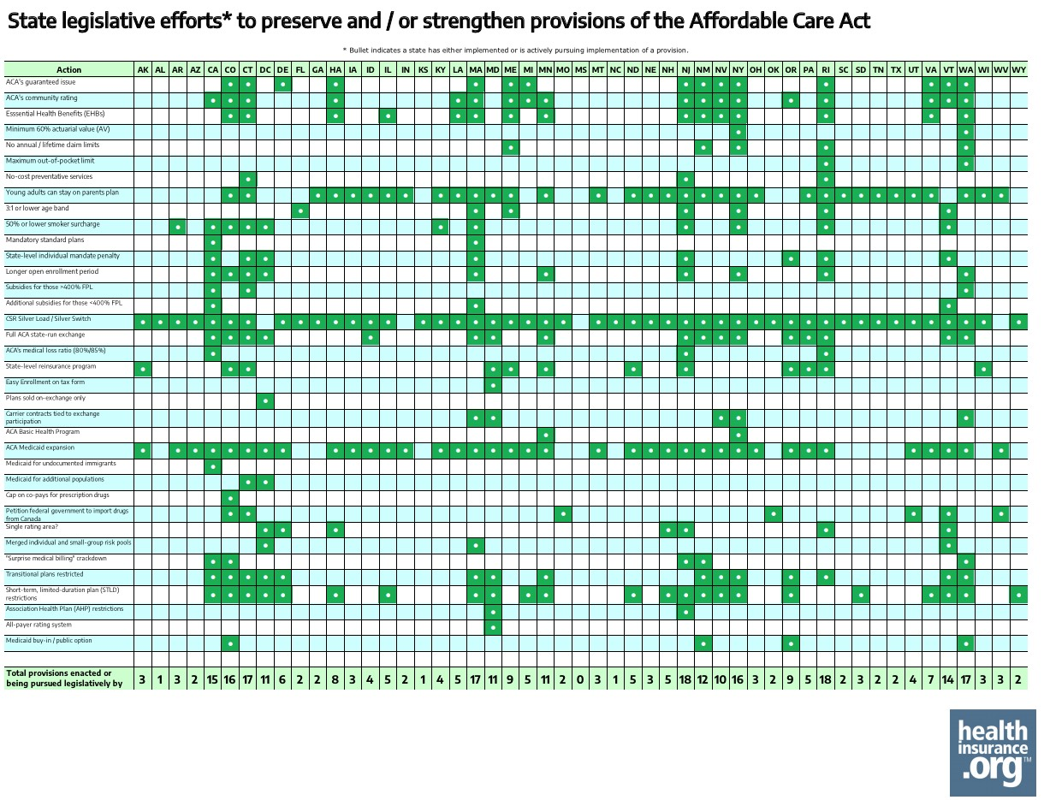

Slide 11
Most Pro-Active States:
Nevada: at least 10 measures
District of Columbia: at least 11 measures
Maryland: at least 11 measures
Minnesota: at least 11 measures
New Mexico: at least 12 measures
Maine: at least 13 measures
California: at least 15 measures
Colorado: at least 15 measures
Connecticut: at least 16 measures
New Jersey: at least 17 measures
Washington State: at least 17 measures
Massachusetts: at least 18 measures
New York: at least 18 measures
Rhode Island: at least 19 measures
Vermont: at least 19 measures

Slide 12
Most Widely-Implemented Measures:
Guaranteed Issue: at least 14 states (to some degree)
Community Rating: at least 17 states (to some degree)
Essential Health Benefits: at least 13 states (to some degree)
Young Adults on Parents Plan: at least 34 states (to some degree)
<= 50% Smoker Surcharge: 11 states
Custom Open Enrollment Periods/SEPs: 13 states (16 next year)
Silver Loading / Silver Switching: All except IN, MS & WV
Full State-based Exchange: 13 states (16 next year; could be up to 5 more by 2023)
Reinsurance Programs: 12 states (5 more pending, various stages)
Medicaid Expansion: 38 states (could be up to 41 next year)
Surprise Bills Restricted/Banned: at least 12 states (to some degree)
Transitional Plans Banned: 19 states
Short-Term Plans Restricted/Banned: 25 states (to some degree)

Slide 13
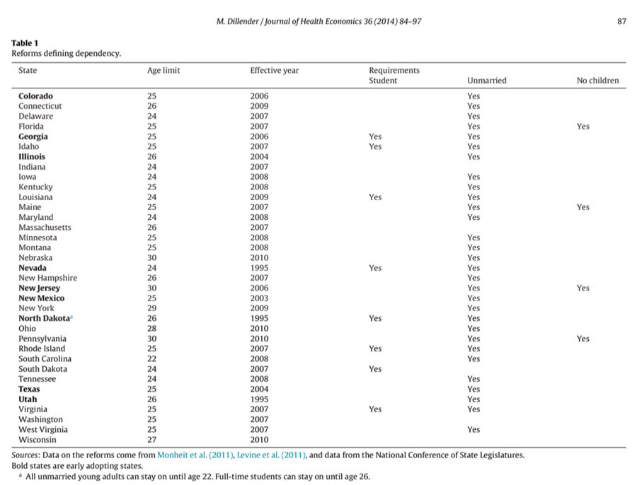
Young Adults on Parents Plan Pre-ACA
Marcus Dillender, Journal of Health Economics, 2014

Slide 14
3:1 or Lower Age Band
Massachusetts: 2:1
New York: 1:1
Vermont: 1:1 (was considering abandoning last yr)
Maine had a 1.5:1 age band pre-ACA but is now 3:1
50% or Lower Smoker Surcharge
Arkansas: 20%
Colorado: 15%
Connecticut: 50%
District of Columbia: 0%
Kentucky: 40%
California, District of Columbia, Massachusetts, New Jersey, New York, Rhode Island Vermont: 0%

Slide 15
MLR Ratio:
Under the ACA, Lg. Group plans required to spend at least 85% of premium revenue on medical claims; Sm. Group & Individual market plans required to spend at least 80%
Via the ACA’s MLR rule, individual market carriers have had to pay back nearly $2.1 BILLION in excessive premiums to policyholders since 2011
2018: $132 million to 967,000 enrollees
2019: $769 million to 3.3 million enrollees
2020: ??? (could potentially hit $1.5 billion or more?)
California & New Jersey codified ACA MLR thresholds
Rhode Island had pending legislation last year, status unknown
Massachusetts Indy/Sm. Group MLR was 90% until 2013, but dropped to 89% in 2014 & 88% in 2015 where it’s stood since
New York has had MLR set to 82% for Indy/Sm. Group markets since 2011

Slide 16
State Contracts Tied to Exchanges:
Maryland: State requires all insurers that participate in the individual market and have earned premiums in that market of at least $10 million to offer plans in the ACA marketplace
Massachusetts: State requires all insurers that participate in the merged individual/small-group market and have enrollment of at least 5,000 in that market to offer plans in the ACA marketplace.
Nevada: An insurer bidding to participate in the state's MCO program receives bonus points, increasing its chance of selection, if it also participates in the ACA marketplace.
New York: State prohibits public health insurance programs (Medicaid, CHIP, BHP) from contracting with insurers that cease participation in the ACA marketplace.
Washington State: Starting in 2020, insurers selected to offer coverage to state public employees or school employees are required to also offer plans in the ACA marketplace.
Commonwealth Fund, “What Is Your State Doing to Affect Access to Adequate Health Insurance?” 11/4/19

Slide 17
Single Rating Area:
Delaware, District of Columbia, Hawaii, New Hampshire, New Jersey, Rhode Island & Vermont all have a single state-wide rating area
Merged Individual & Small Group Risk Pools:
District of Columbia, Massachusetts & Vermont have all merged the two markets. Maine just announced that they’re seeking to do so as well.

Slide 18
Transitional/Grandmothered Plans:
Under the ACA, non-compliant individual market major medical plans were originally only allowed to continue for existing enrollees if they enrolled prior to 2010 (“Grandfathered plans”)
Due to “If You Like It You Can Keep It” backlash, Obama Administration issued a 1-yr extension waiver for non-ACA plans enrolled in between 2010 – 2013 (“Grandmothered”)
2/3 of states took the extension, 1/3 didn’t
1-yr extension became a 3-yr extension…then 4, then 5…
As of today, 32 states still allow non-ACA compliant individual market plans originally enrolled in between 2010 – 2013. Perhaps 1 million still enrolled (?)
Discontinuing these, as with restricting/banning short-term, sharing ministry, association, etc. non-ACA compliant plans would improve ACA enrollment & risk pool.

Slide 19
EXPANDED / ENHANCED SUBSIDIES:
Massachusetts & Vermont have been offering supplemental subsidies to low-income (under 300% FPL) enrollees for years on top of ACA subsidies
Washington State passed a law in 2019 supposedly requiring expanding subsidies to 400-500% FPL enrollees starting in 2021 (?)
California is the first state to actually offer expanded subsidies to ACA exchange enrollees earning 400 – 600% FPL
California also offering enhanced subsidies to those earning 200 – 400% FPL
Official ACA formula: Ranges from 2 – 9.8% of income for Benchmark Silver for enrollees earning 100 – 400% FPL
California’s formula: Shaves cap down between 200-400% FPL, limits premiums to 9.7% - 18.0% between 400-600% FPL

Slide 20
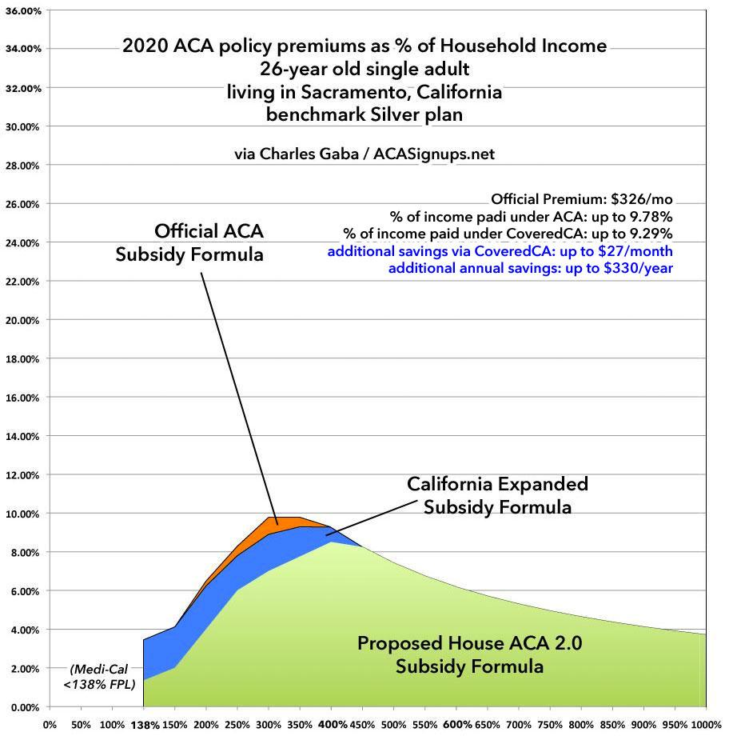

Slide 21
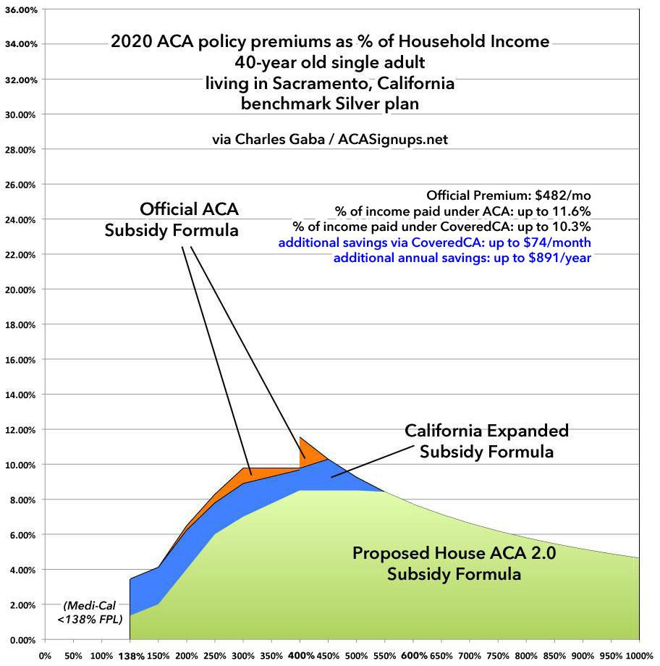

Slide 22
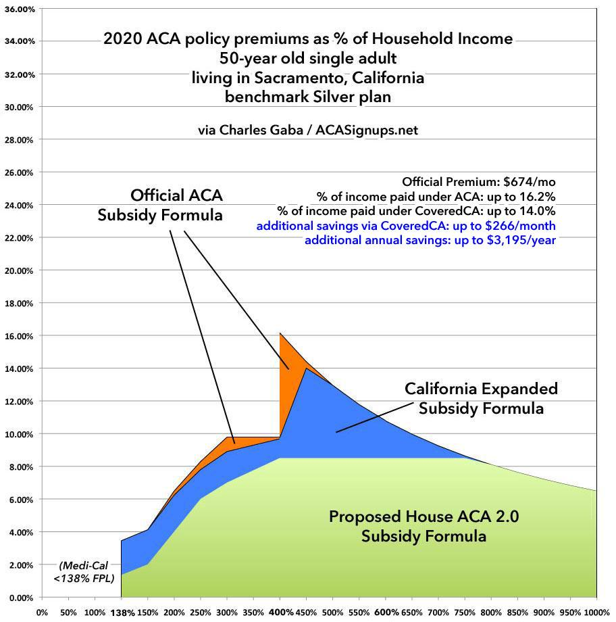

Slide 23
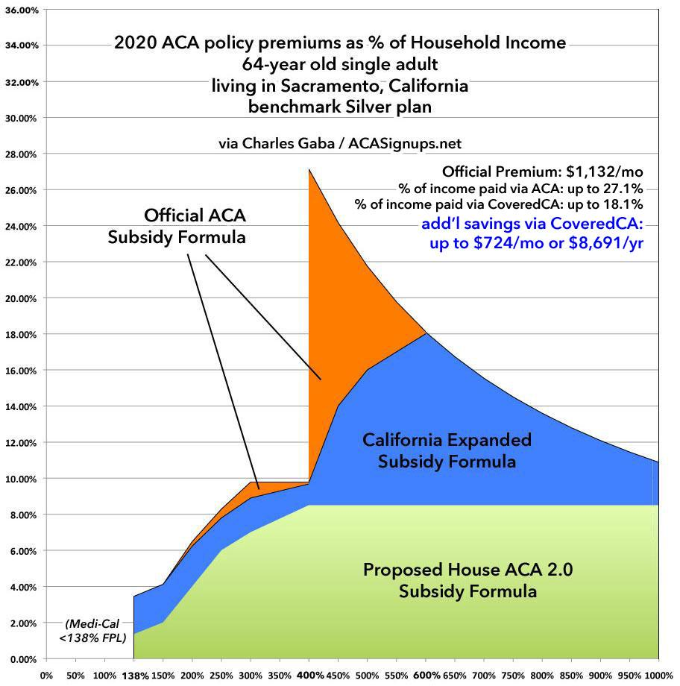

Slide 24
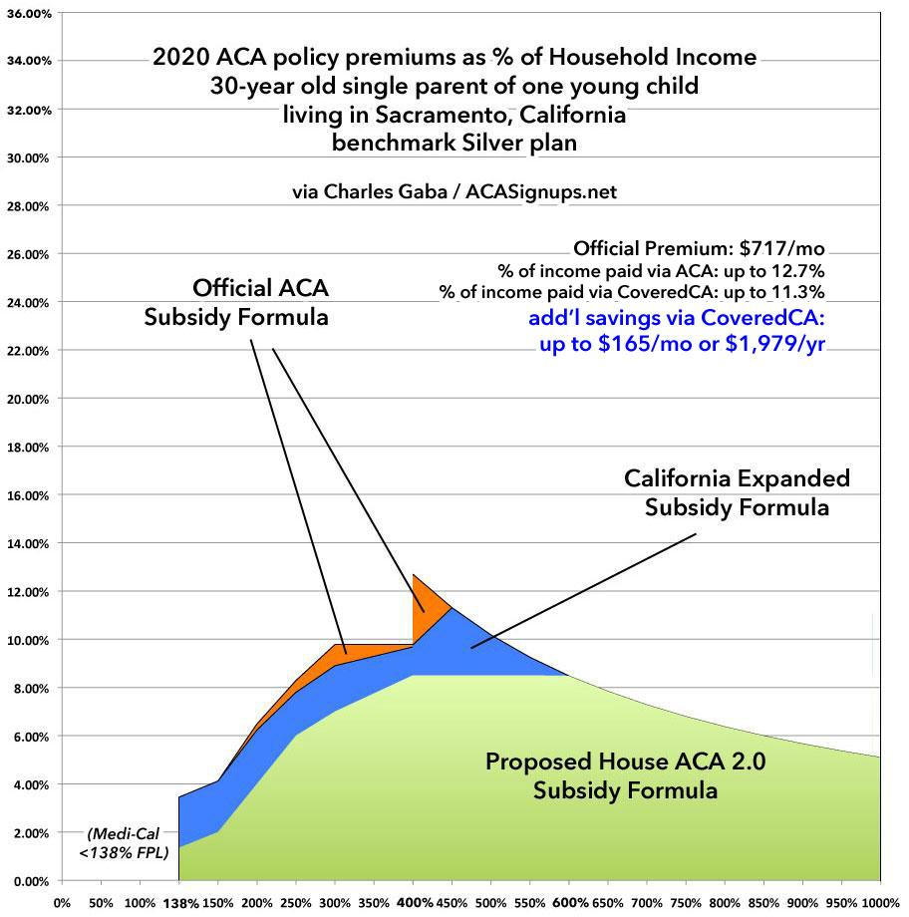

Slide 25
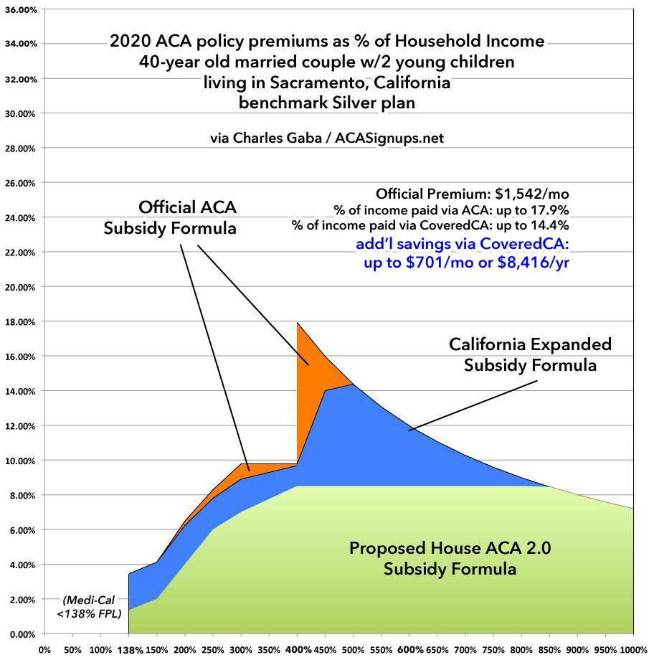

Slide 26
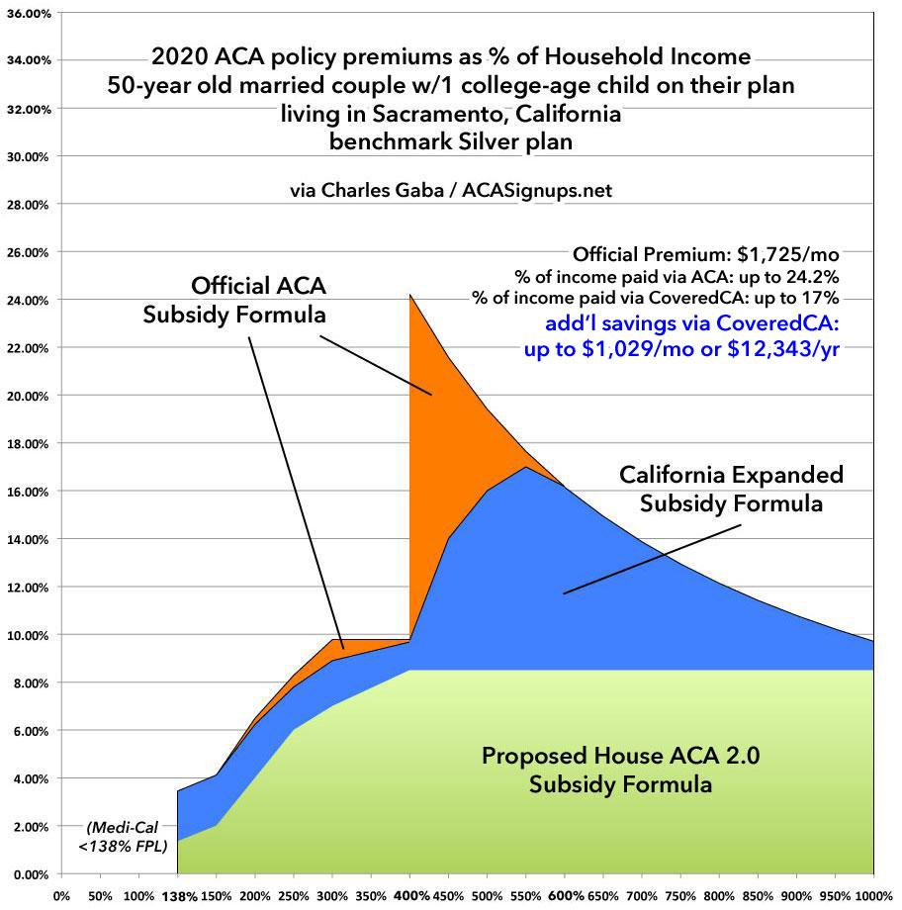

Slide 27
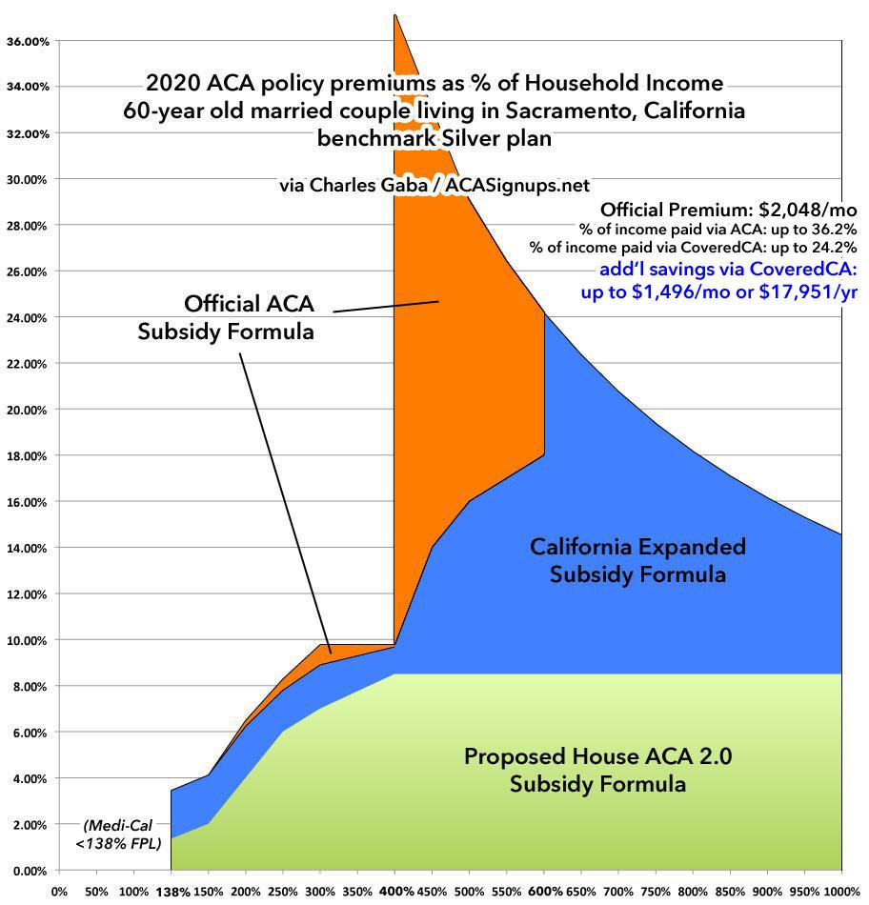

Slide 28
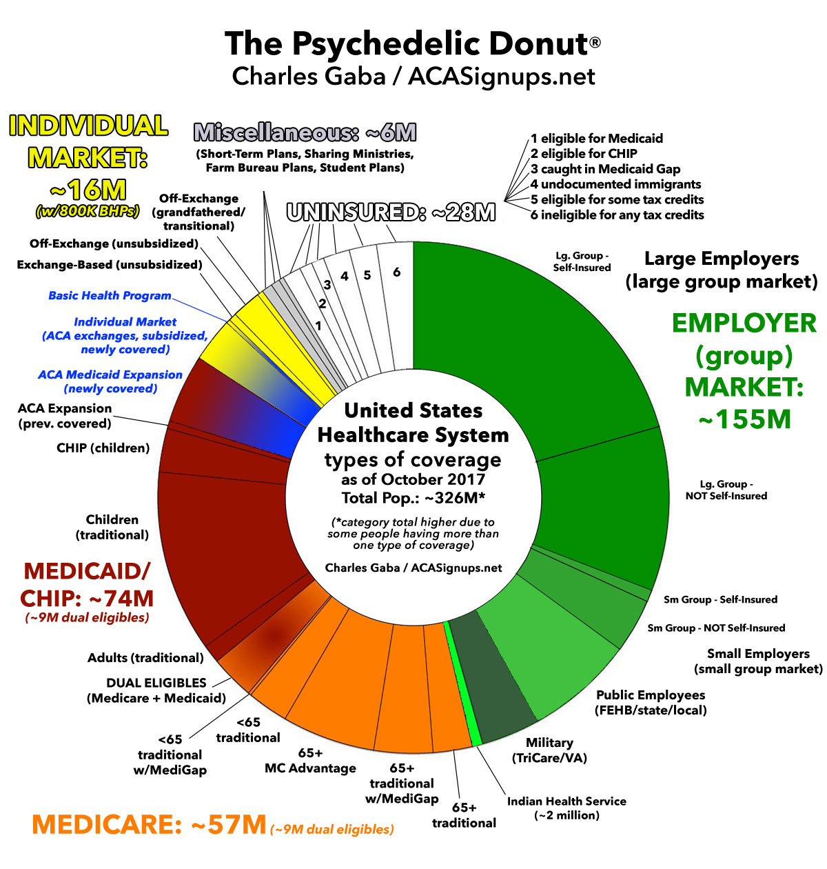

Slide 29
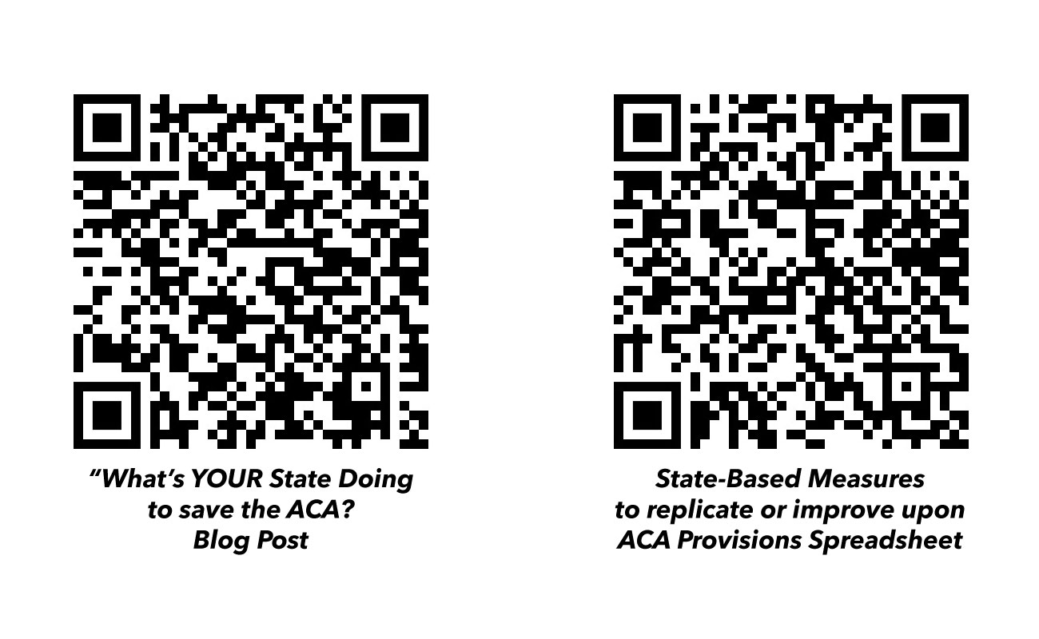

Slide 30
Charles Gaba
Web: ACASignups.net
Phone: 248-545-7570
Email: cgaba@acasignups.net
Support: Patreon.com/CharlesGaba

