Slide 1
Fighting Back Against Attacks on Immigrants’ Health Care: a National Perspective
Gabrielle Lessard
National Immigration Law Center
Lessard@nilc.org

Slide 2
Who We Are
National Immigration Law Center
Protecting Immigrant Families
Our mission is to defend & advance the rights & opportunities of low-income immigrants and their family members.
We combine policy advocacy, litigation and strategic communications
A campaign to protect and defend access to health care, nutrition programs, public services, and economic supports for immigrants and their families at the local, state, and federal level.
Co-chaired by NILC and the Center for Law and Social Policy (CLASP)

Slide 3
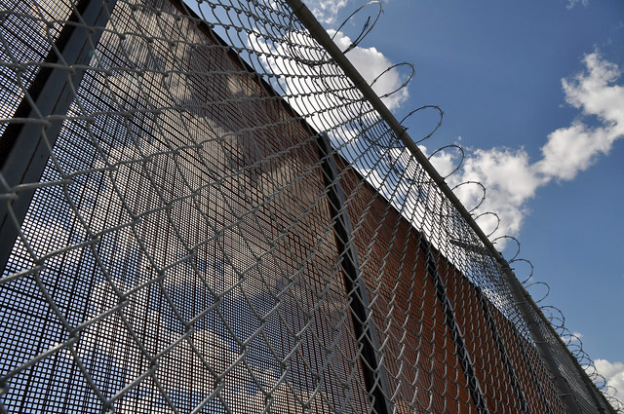
The Invisible Wall
Administration policies that impede lawful immigration and discourage families in U.S. from accessing essential benefits like health care, nutrition and housing assistance.
Notes:
The administration talks about enforcing the immigration laws but they have adopted a number of policies that impede or deter people who are in the legal immigration process to obtain status, to remain in status and even to get essential services like food and healthcare. These attacks often focus on immigrants who are lower-income and POC. We call that the ‘Invisible Wall’

Slide 4
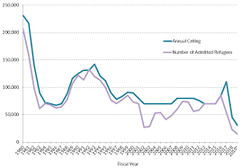
Barriers to Immigration
Dramatic reduction in refugee admissions
Repeated attempts to deter asylum seekers
Policies that interfere with family-based immigration
Health Insurance Proclamation
Source: Migration Policy Institute
Notes:
Refugees – last year 23,000, less than Canada (we have 10x the population) FY2020: 18,000
MH mentioned proclamation yesterday

Slide 5
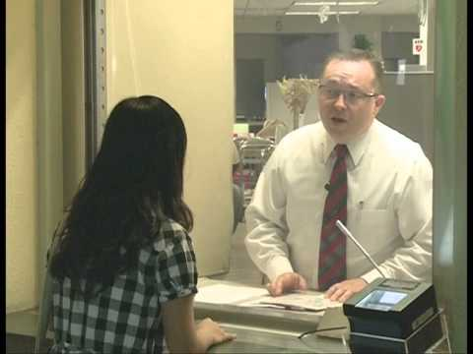
Health Insurance Proclamation
Requires visa applicants to show that they will have unsubsidized health insurance within 30 days after coming to the US
or resources to pay for care
Plans do not need to be ACA compliant
Exceptions include kids in Medicaid
This Photo by Unknown Author is licensed under CC BY
more info
Notes:
Immigration restriction
Travel insurance and short-term junk plans
Reasonably foreseeable medical expenses.

Slide 6
Punishing Lawfully Present Immigrants
Attempts to terminate DACA and TPS
‘Extreme vetting’ policies causing dramatic increase in processing backlog at U.S. Citizenship and Immigration Services (USCIS)
Attempts to deter access to essential food, medical and housing benefits
HUD proposal to force mixed-status families to separate or move out of public housing
Public Charge
Notes:
DACA/TPS terminations enjoined. USCIS backlog up 29% since 2016. Rescission of deference to prior adjudications of eligibility for immigration benefits
WH memo – directed HHS and USDA to issue new guidance on when sponsor’s income could be counted as available to sponsored immigrants applying for Medicaid/CHIP & SNAP and when sponsors could be pursued for repayment of benefits. HHS guidance directed states to count sponsor’s income on Medicaid/CHIP applications, with exceptions. USDA guidance affirmed existing practices. Both made clear that pursuing sponsors for repayment is optional

Slide 7
Public Charge
Notes:
Have been hearing news reports about

Slide 8
Department of Homeland Security
Final Rule Published
Blocked by the courts
State Department
Interim Final Rule Published
Put on hold by agency
Department of Justice
Not yet published
Affects people who have become public charges in the U.S.
Affects people applying for LPR status in the U.S.
Affects people applying for visas or LPR status outside the U.S.

Slide 9
Public Charge: Key Facts
A public charge is a person who is dependent on the government for support
A person who is deemed to be likely to become a public charge in the future can be denied:
permission to come to the US or
lawful permanent resident (LPR) status (a green card)
In rare cases, a person can be deported for having become a public charge
Notes:
Humanitarian immigrants are exempt

Slide 10
Who is Subject to Public Charge?
Public charge primarily affects family-based immigrants
Many humanitarian immigrants are exempt from Public Charge inadmissibility, including:
Refugees and asylees
survivors of traf­ficking (T visa)/other serious crimes (U visa)
self-petitioners under the Violence Against Women Act

Slide 11
Statutory Factors
Federal Immigration law requires officials to consider a person’s ‘totality of circumstances’ in deciding whether they are likely to become a public charge in the future
Age
Income and
Financial Status
Health
Education and Skills
Family Status
Affidavit of Support
Notes:
GABRIELLE
Boxes represent the totality of circumstances test as set forth in the law
Now we’re going to spend some time quickly walking through the totality of circumstances test under the proposed rule. As I mentioned in my overview of the changes, the proposed rule adds new factors to this test which make it much harder for low income and working class families to pass, regardless of whether they have used public benefits. .

Slide 12
What would the DHS rule change?

Slide 13
DHS Public Charge Rule
NEW DEFINITION
TOTALITY OF CIRCUMSTANCES
ADDITIONAL
BENEFITS
A dramatically different definition of public charge
New weighted factors of the totality of circumstances test make it harder for low and moderate income people to pass
Additional public benefits programs could be considered by immigration officials.
Notes:
TOC adds specific income thresholds – 125%/250%, consideration whether health condition would be require expensive treatment or institutionalization or

Slide 14
DHS Public Charge Rule: Definition
DHS Regulations
A person who “receives one or more public benefit… for more than 12 months in the aggregate within any 36-month period (such that, for instance, receipt of two benefits in one month counts as two months).”
Current Definition
An immigrant “likely to become primarily dependent on the government for subsistence”
Notes:
Gabrielle - a person who is more likely than not to receive one or more of certain public benefits for over 12 months in a 36 month period;
non-immigrants who have used the threshold amount of benefits could be denied extension or change in status (though generally won’t be eligible for the benefits, or exempt from the rule)

Slide 15
Totality of Circumstances
Negative if:
You are younger than 18 or older than 62
Your income is below 125% of the federal Poverty Level
You have been diagnosed with a health condition that will require expensive treatment / could affect your ability to study or work
You have less than a high school education
You have limited proficiency in English
Notes:
Not an exhaustive list
Heavily weighted factors repeat these, add a heavily weighted positive if a person

Slide 16
Which benefits are considered?
Federal, state, local or tribal cash assistance for income maintenance, and
Medicaid (with exceptions)
SNAP (Food Stamps)
Section 8 housing assistance
Public housing
This Photo by Unknown Author is licensed under CC BY-NC-ND
Notes:
Benefits received by or attributed to the person

Slide 17
Medicaid Exceptions
Emergency Medicaid
Health benefits received by a person under 21 years of age
Health benefits received during pregnancy and for 60 days after
Notes:
Emergency defined by reference to emergency Medicaid but can be through full-scope

Slide 18
Excluded Benefits
Everything not listed!
WIC
ACA financial assistance
Sliding scale financial assistance at health centers
Medicare Part D financial assistance
State and local non-cash benefits
Benefits received by other family members
This Photo by Unknown Author is licensed under CC BY-SA
Notes:
No retroactivity

Slide 19
Strategies for Advocates

Slide 20
Strategies
Organize your network
NILC and CLASP formed the Protecting Immigrant Families Campaign in 2017. The Campaign now has over 400 active member organizations.
OMB strategy
We created resources for state and local officials and service providers to meet with OMB about the rule’s economic impact, which delayed its publication
Comment Period
We created research-informed template comments and encouraged others to comment. Over 260,000 comments were submitted, creating an administrative record for litigation
Participate in Litigation
Not just for lawyers! Your organization can be a plaintiff, write an amicus brief or tell your story to the press

Slide 21
Litigation Update
A New York Federal District Court (trial court) issued a Nationwide Preliminary Injunction - an order that maintains the status quo while an issue is being litigated
The Government asked the Second Circuit Court of Appeals for a stay – an order that would negate the Preliminary Injunction
The Second Circuit denied the stay
The Government asked the Supreme Court to review the denial of the stay
The preliminary injunction remains in effect
The DHS rule cannot go into effect anywhere in the U.S.
Notes:
That there is a substantial likelihood of success on the merits of the case,
That they face a substantial threat of irreparable damage or injury if the injunction is not granted,
The threat is immediate,
That the balance of harms weighs in favor of the party seeking the preliminary injunction,
There is no other available remedy,
That the grant of an injunction would serve the public interest.

Slide 22
What’s next? Three scenarios
The injunction will continue to block the rule if:
The Supreme Court declines to hear the case or
The Court denies the stay
The rule could go into effect if:
The Supreme Court grants the stay
The decision will be limited to the Preliminary Injunction
Notes:
Not retroactive, not necessarily immediate

Slide 23
Litigation is ongoing
In addition to the 2nd circuit (New York) cases, there are cases in:
California, Washington (9th circuit)
Illinois (7th circuit), and
Maryland (4th circuit)
None of these courts have had hearings on the merits (validity) of the DHS rule yet
This Photo by Unknown Author is licensed under CC BY-SA
Notes:
9th – CA, WA
4th – MD
7th Illinois
2nd NY

Slide 24
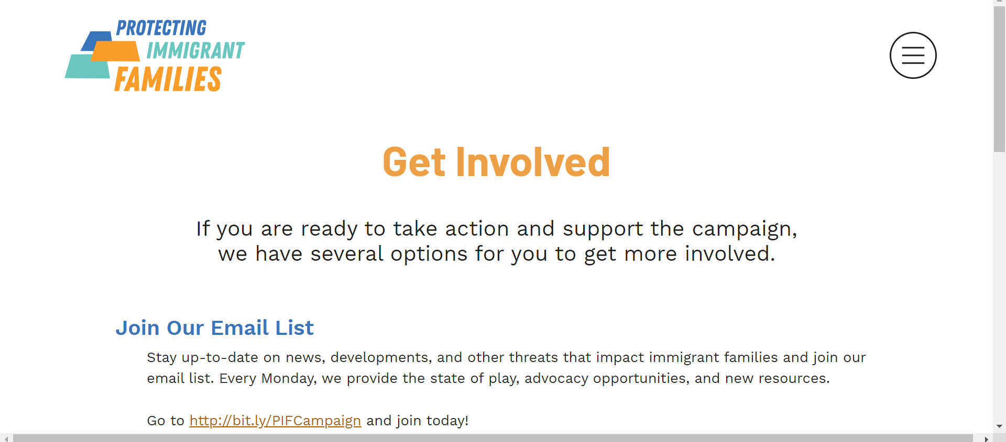
ProtectingImmigrantFamilies.org

Slide 25
Education and Outreach Resources
Key community messages and critical information about Public Charge.
Materials to ensure people understand how public charge does and does not affect them.
Fact sheet - Overview of the final rule and a summary of expected consequences, including the chilling effect on all immigrant families.
Samples of community-facing materials in that you can customize

