Slide 1
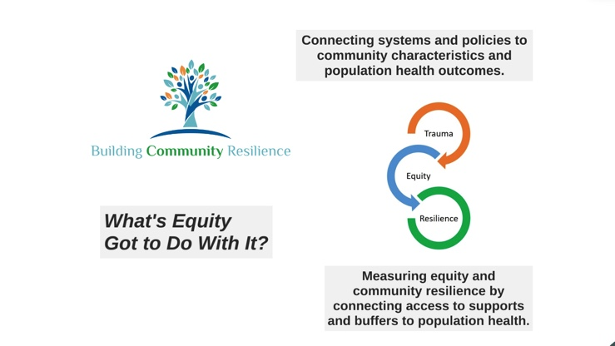

Slide 2
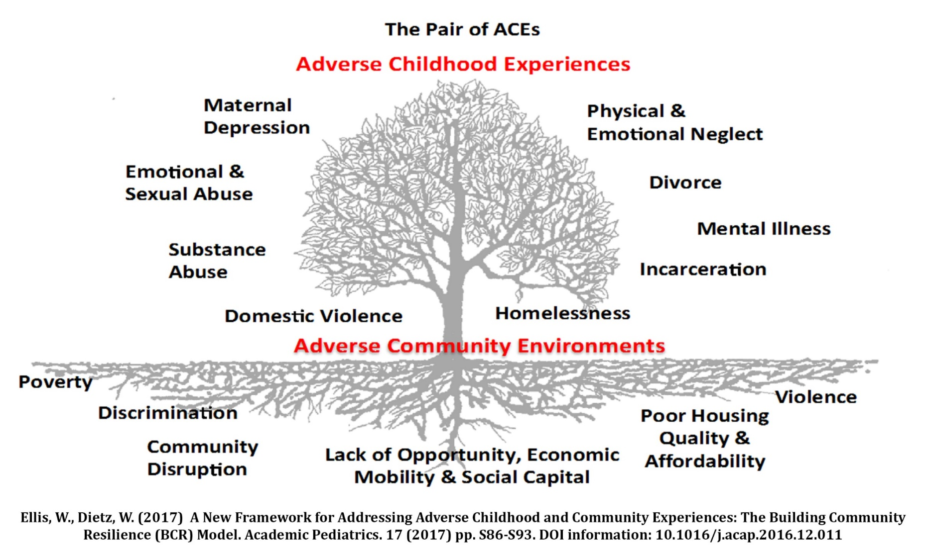
Outcomes
Policy and Practice
40
Notes:
The Pair of ACEs tree is one way we frame our work;
The tree illustrates the adversities that must be addressed to build and support resilient communities and families.
The leaves on the tree represent adverse childhood experiences (ACEs) that are often recognized in clinical, educational and social service settings and can impact a person’s wellbeing and health throughout their life.
The tree is planted in poor soil – adverse community environments (ACEs) – that is steeped in systemic inequities, robbing it of nutrients
Question came in about additions to the ACEs list…Beyond the original ACEs from the Fellitti/CDC study to look at community level factors…Philadelphia ACEs study…violence…discrimination, etc
Using the tree as a framework has allowed our communities to better describe and contextualize the problems they are trying to solve; it also provides a means to ground their work within the particular circumstances and history of their communities (many of our sites often use a blank pair of ACEs tree to allow their communities to name the adversities that they see in their work…it also allows them to think about what a healthy and resilient tree would look like);
The ability to acknowledge and name community trauma has been particularly powerful for many of our sites to work not just on the individual or interpersonal traumas that community members are facing, but begin to look deeper at the type of systems level change that is need to support a resilient community;
The tree also serves as an important frame for how we measure and evaluate our work- we want to examine outcomes at the program level as well as measure progress at the collaborative level, which might better represent the type of systems-level change our teams are seeking

Slide 3
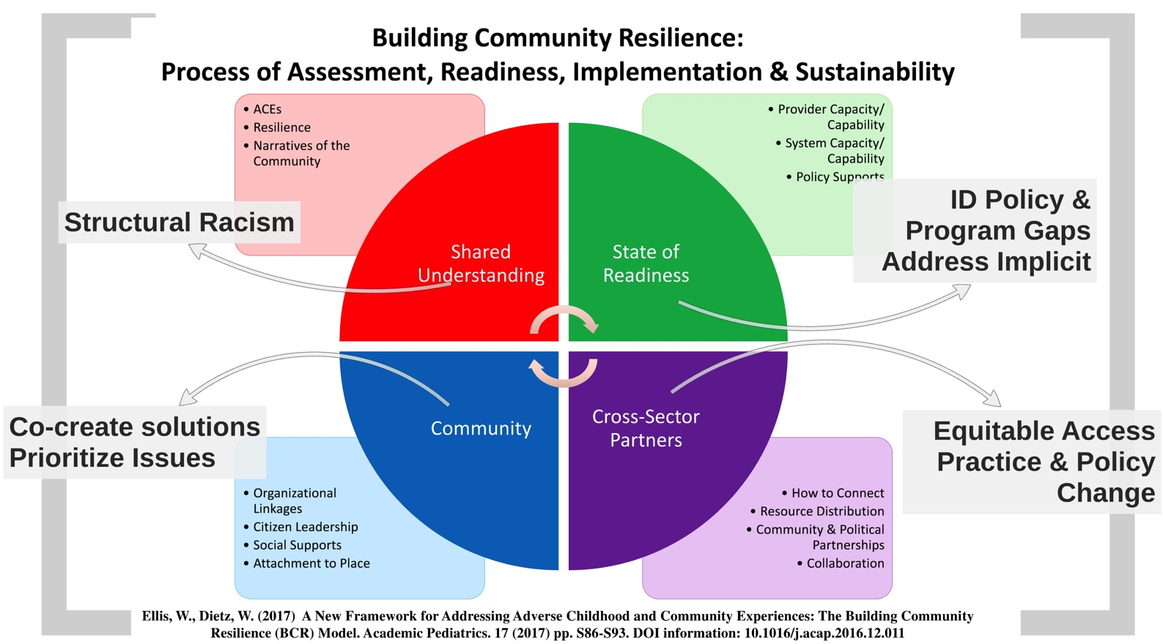

Slide 4
National Smart Start Conference
Building Community Resilience
May 1, 2019
Jeff Hild, Redstone Center, GWU School of Public Health
jeffhild@gwu.edu
Learn More: go.gwu.edu/BCR

Slide 5
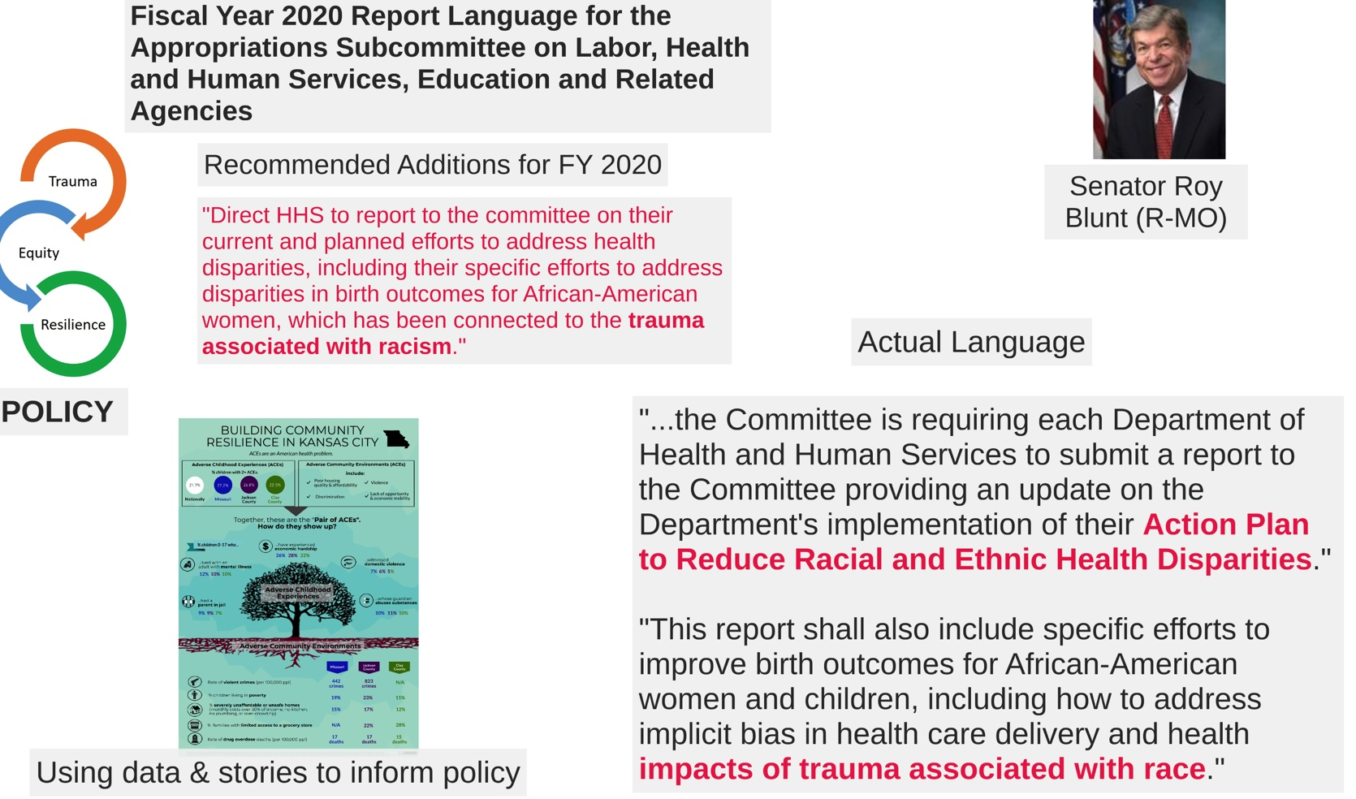

Slide 6
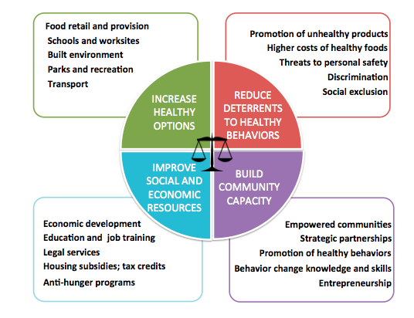
Obesity Prevention Health Equity Framework
Kumanyika S. National Academy of Medicine Perspective January 18, 2017

Slide 7
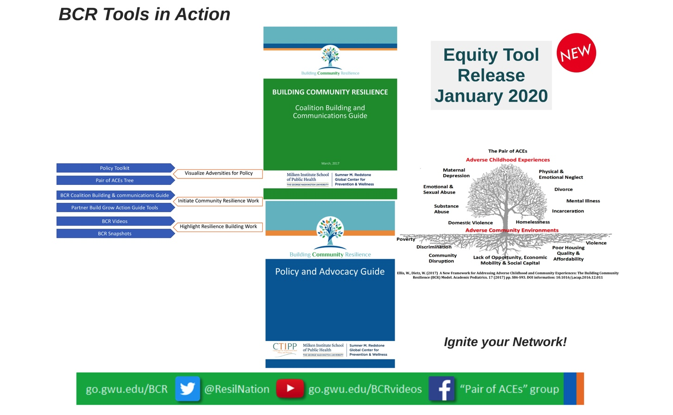

Slide 8
Jeff Hild
Policy Director, Redstone Center GWU School of Public Health
jeffhild@gwu.edu, 202.994.3637
@jeffhild1, @RedstoneGWSPH, @ResilNation
go.gwu.edu/BCR

