Slide 1

Missouri Health Care for All
Pillars for a new American
health care system

Slide 2
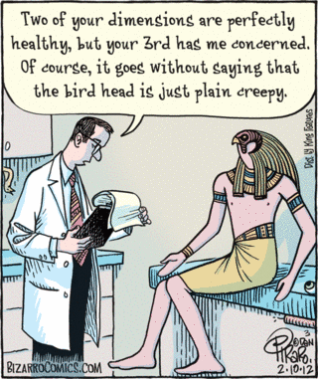
A
Long,
Long
Time
Ago…
…In 2007

Slide 3


Founding Landscape: April 2007
2005 Medicaid cuts→fractured health advocacy field
President George W. Bush
MO Governor Matt Blunt
No central health reform plan
Goal: Unite health advocates into a powerful, values-based movement

Slide 4
2007-2017
Principles
Budget Cuts x 3
Affordable Care Act
Medicaid Expansion
Rate Review
Surprise Medical Bills
ACA and Medicaid Defense

Slide 5
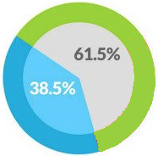
2018
Grassroots supporters: “What is the long-term vision?”
MEMBER SURVEY: Of these two things, which would you like MHCFA to focus on more?
Transforming the health care
system to a universal system.
Improving our current health care system.

Slide 6
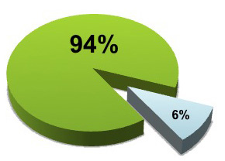
2018
MEMBER SURVEY: Single-payer, universal health
care, or Medicare for All; do you think MHCFA should advocate for a health care system where
everybody has equal access to health care?
Yes
No: 2.5%
Unsure: 3.5%

Slide 7

Pillars for a New American Health Care System
“After more than a decade of working for change, and after talking with thousands of Missourians who still can’t get the care they need, we also believe that these incremental improvements will never be enough to truly guarantee care for every person.
“The U.S. has some of the best doctors in the world, but we need a fundamentally transformed health care system that allows every American to benefit.”

Slide 8
Pillars for a New American Health Care System
“While there are several ways to provide universal care, we believe the best model for the United States would be to build upon Medicare’s long-standing history of success.
“Medicare for All is the most prudent, simplest, and proudly American solution to our health care crisis.”

Slide 9

Pillars for a New American Health Care System
1
One Integrated System.
Everyone in the should be automatically covered under thcountrye same system. This includes all children, adults, and seniors, and particularly includes elected officials. If members of Congress
are in the same program, it will be a lot
harder for them to damage it.

Slide 10

Pillars for a New American Health Care System
2
Freedom to Choose Your Health Care Provider.
Restrictive provider networks keep people from getting care. Everyone should have the personal freedom to control their own health
care decisions and seek care from any
doctor, hospital, or health care
professional.

Slide 11

Pillars for a New American Health Care System
3
No Cost Barriers to Care.
Individual out-of-pocket costs for care — such as deductibles and copays – should be eliminated or minimal. Any cost-sharing requirements should exempt Americans for whom they would serve as a barrier to care, and they should be structured in a way that is transparent and truly affordable to the people who will be required to pay. This includes health care services as well as prescription drugs and medical devices.

Slide 12

Pillars for a New American Health Care System
4
Comprehensive Care.
All medically-necessary services and products must be covered. This includes, but is not limited to, office visits, hospital care, prescription drugs, medical equipment, vision, dental, hearing,
mental health, services for people with
disabilities, and non-emergency
transportation.

Slide 13

Pillars for a New American Health Care System
5
Economically Prudent.
Funding should be structured so that everyone pays their fair share, and nobody is priced out of health care due to inability to pay. This can be done through a variety of publicly financed models, but the bottom line is that both families and businesses will see a positive net increase
in their budgets.

Slide 14

Pillars for a New American Health Care System
6
Emphasis on Community Health and Equity.
Health care systems work best when they place strong emphasis on preventive care, community health, and epidemics. Programs should be customized to fit the needs of each Missouri community, as part of a national
strategy to reduce and then eliminate
health disparities based on race,
income, and, geography

Slide 15
Activities
Continued short-term defense and offense work
Partner on public education events
Share with members
and partners
Prepare for future
opportunities

Slide 16

Missouri Health Care for All
Jen Bersdale
Executive Director
jen@mohealthcareforall.org
314-651-6568
Toll Free: 877-383-8884
missourihealthcareforall.org

