Slide 1
The Children’s Partnership
Health4All Kids:
California Coverage for All Children
Families USA Conference
Kristen Golden Testa
Health Director
January 23, 2020

Slide 2
Our Mission
The Children’s Partnership (TCP) is a California-based national children’s advocacy organization committed to improving the lives of underserved children where they live, learn, and play with breakthrough solutions at the intersection of research, policy, and community engagement.
Since 1993, TCP has been a leading voice for children and a critical resource for communities across California and the nation, working every day to champion policies that provide all children with the resources and opportunities they need to thrive.

Slide 3
Overview
Health4All Kids: CA’s coverage for all children
How We Got Here: Lessons from CA
What we are Doing in Federal immigration environment
State response
Community/Advocacy Response

Slide 4
Health4AllKids (SB 75 Lara)
Medicaid for all children regardless of immigration status
Under age 19
Incomes below 266% FPL
About 130,000 immigrant children enrolled
Enacted in 2015, started May 2016

Slide 5
Health4All Kids—How we got here
[can’t locate our california lessons report from 2016/17]
www.childrenspartnership.org/wp-content/uploads/2018/01/Golden-Opportunity-Lessons-From-Californias-Journey-to-Advancing-Coverage-for-All-Children-Report.pdf

Slide 6
Health4All Kids: How We Got Here
Demographics—California is America Fast Forward
Persistence over the long journey
Bold Goal–Coverage for All Children
Built Locally and the power of grassroots advocacy
Philanthropic front-end and sustained investments
Statewide Policy and Advocacy
Coalition around Immigrant Equal Rights/Social Justice
Value Community Partners to build trust and sustain change

Slide 7
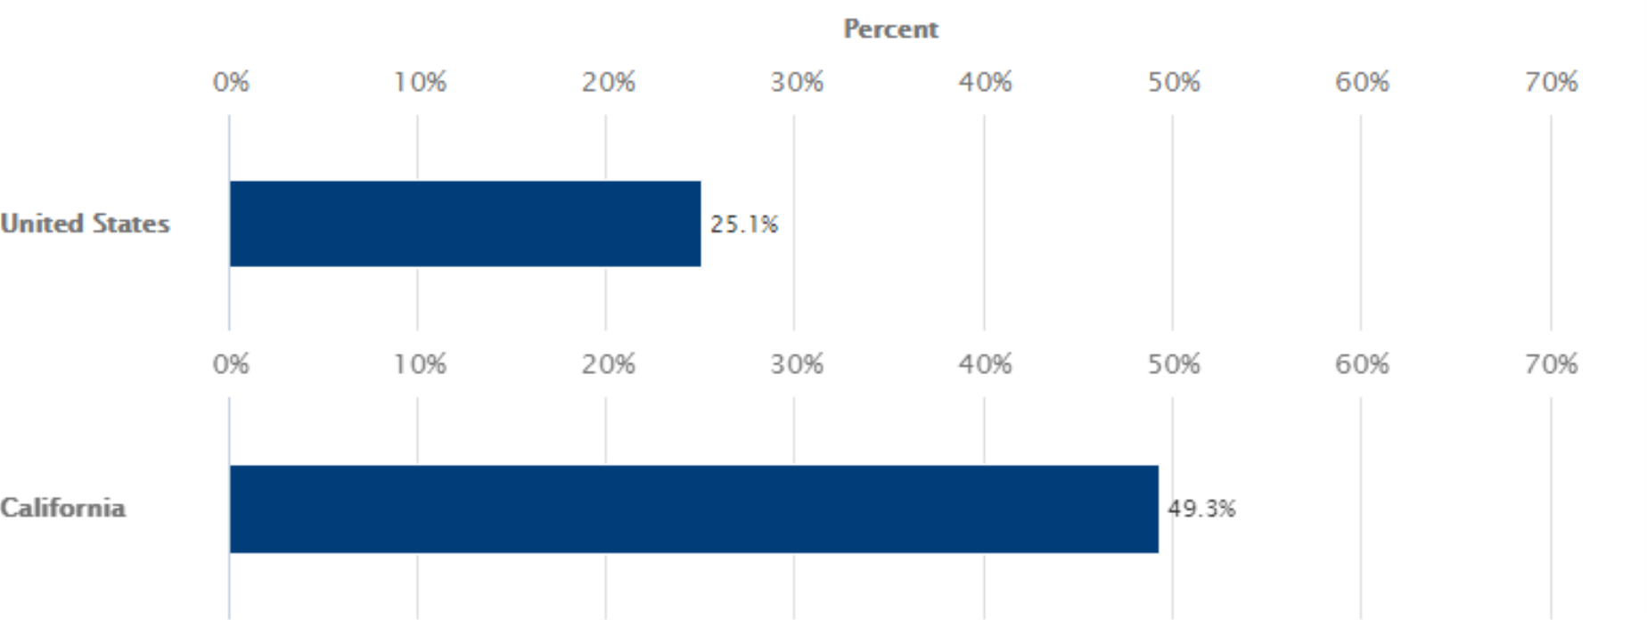
How We Got Here: Demographics
Children Living with Foreign-Born Parents (10,000 Residents or More): 2012-2016
Source: Kidsdata.org (Lucile Packard Foundation for Children's Health)
Notes:
Facts on children in immigrant families
Definition: According to the Population Reference Bureau, children in immigrant families are children under age 18 who are foreign-born or who reside with at least one foreign-born parent. Foreign-born include non-citizens and U.S. citizens by naturalization. Native-born include those born in the U.S., Puerto Rico, Guam, Virgin Islands, or the Northern Marianas or born abroad of American parents.
Significance: Children in immigrant families are the driving force behind future growth of population, labor force, economy.
49.5% of children in California have at least one immigrant parent. (Source: Kids Data)
In 2011-2014, the estimated percentage of children living with one or more foreign-born parents was 49.5%. Kids Count reports a slightly different percentage (48% or 4,367,000 children, 2015).
About 1 in 8 K-12 students in California have at least one parent who is undocumented. (Source: Pew Research Center)
750,000 (12.3%) K-12 students in California have at least one undocumented parent, 2014 estimate.

Slide 8
California is America Fast Forward
CA Children, by Race/Ethnicity,
2018
Source: Kidsdata.org
Notes:
Corresponding power and economic shifts:
--greater legislative representation 10-25% latinx
--economic: by 2050 children of immigrants will be the predominant contributors to the economy. Half the US workforce will be those. children.
Investing in the well being of this future workforce is fundamentally a macro economic imperative.

Slide 9
How We Got Here: Persistence Through the Long Journey
1994 Anti-immigrant Ballot Initiative Passes (Prop 187)
2001 First Local “Healthy Kids”
2004-2006 Statewide “Coverage for All Kids” bills/ballot initiatives
2010 ACA Culture of Coverage
2013 Driver’s Licenses for all residents
2014 ACA coverage expansions begin/Focus on “Remaining Uninsured”
2015 Health for All Kids passes !
2016 Health for All Kids starts
2019 Health for All Young Adults
2020 Governor proposes Health for All Seniors

Slide 10
How We Got Here: Locally Grown
True Grassroots: Local community action for “our” children
PICO—Community organizations
Local health plans
Labor unions
Counties
Bold and Direct Goal-- Coverage for All Children
Message: “A Kid is a Kid”
28 “Children’s Health Initiatives (CHIs) across 30 counties
21 Healthy Kids local insurance products
Notes:
Community—this is who we are—our children
In the churches, workplace, schools, civic

Slide 11
How We Got Here: Sustainability through Equal Rights
Strategic and coordinated statewide philanthropic support
Statewide policy and messaging research
Broad health coalition built on grassroots
Health reform frame faced the usual political hurdles
Rights coalitions
How We Won:
Social Justice/Equity framing from Immigrant Rights coalitions
Notes:
--Foundation funding for HKs not sustainable –strategic to build critical mass
--Remaining uninsured from health side; equity (california for all).
--”Just kids” was a huge disappointment but incremental progress being made

Slide 12
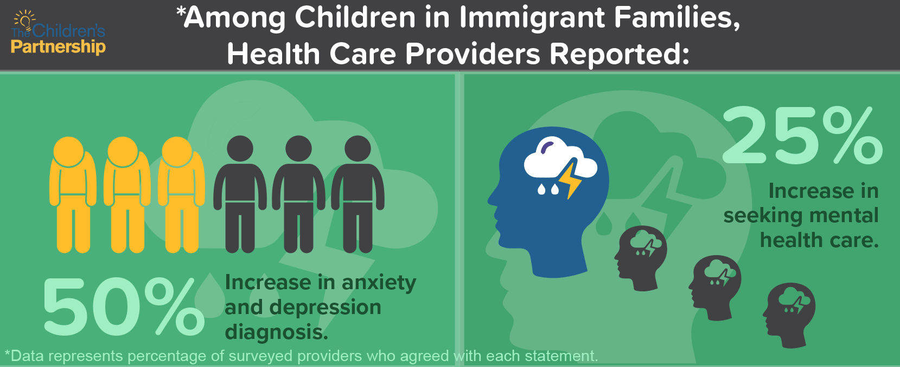
And Now…Federal Immigration Policies Impacting Children’s Health
Family Separation from deportation
Immigration Status Uncertainty (e.g. DACA, public charge)
Economic Instability
Chilling Effect on Enrollment
Reduced Use of Health Care
Toxic Stress and Impacts on Mental/Behavioral/Physical Health
Notes:
On September 5, 2017, President Trump ordered the Department of Homeland Security (DHS) and the US Citizenship and Immigration Service (USCIS) to phase out and eventually terminate Deferred Action for Child Arrivals (DACA) over a period of two and a half years. This means that, as of September 5, 2017: • USCIS will continue processing all initial requests that were received on September 5, 2017. • USCIS will reject any initial requests received after that date. • USCIS will continue to process all renewal applications that were filed on September 5, 2017. • USCIS will only accept and process renewal applications until October 5, 2017 of those applicants whose DACA expires between September 5, 2017. 2017 and March 5, 2018. Those DACA recipients whose work permits have already expired are no longer eligible for renewal. • USCIS will reject all initial and renewal applications received after October 5, 2017.
In California, 220,000+ DACA recipients
25% of DACA recipients are parents
In California, DACA receipients are eligible for full-scope Medi-Cal
Sensitive Locations (2011 ICE Memo) which all current health entities and CBOs have used as the foundation for saying information is intended only for health care eligibility purposes.
Schools (pre-schools, primary schools, secondary schools, post-secondary schools, colleges and universities, and other learning institutions such as vocational or trade schools);
• Hospitals;
• Churches, synagogues, mosques, or other institutions of worship, such as buildings rented for the purpose of religious services;
• Site of a funeral, wedding, or other public religious ceremony; and
• Public demonstrations, such as a march, rally, or parade.
The Protecting Sensitive Locations Act would codify the Department of Homeland Security policy on sensitive locations and expand it to include: courthouses; additional health care, educational, and religious facilities; and other public spaces where the threat of immigration enforcement may deter individuals from seeking services or participating in their community. State
For the notes: The bill would also require DHS to provide training to officers and report to Congress on any enforcement activity occurring at sensitive locations. Additionally, it contains the same exception for exigent circumstances outlined in the DHS memos.
Our Ask on the DREAM Act: Pass a CLEAN Dream Act (no funding for a border wall or enforcement)
Background: Medicaid and other health insurance and health services (including public assistance for immunizations and for testing and treatment of symptoms of communicable diseases, use of health clinics, short-term rehabilitation services, prenatal care and emergency medical services)
Reference: https://www.uscis.gov/news/fact-sheets/public-charge-fact-sheet
http://www.iibayarea.org/wp-content/uploads/2015/03/How-To-Enroll-in-Medi-Cal-DACA-v1.pdf
Individuals can get legal screenings to determine if they have other options to adjust their immigration status.
Everyone should learn about their legal rights
Develop a preparedness plan in case of detention or deportation
For more information and resources visit:
http://www.childrenspartnership.org/communityengagement/defenddaca/
NOTE: No executive order on public benefits at this time, but fear in immigrant communities related to leaked policy proposal and public comments.
USCIS defines “public charge” as an individual who is likely to become “primarily dependent on the government for subsistence, as demonstrated by either the receipt of public cash assistance for income maintenance, or institutionalization for long-term care at government expense.”

Slide 13
State Response: California
State Attorney General Xavier Becerra
State Legislation
2017: SB 54 (De Leon): California Values Act
2017: AB 699 (O’Donnell): Educational equity: immigration
2018: AB 1862 (Santiago, Carrillo): $10 million added to One California for TPS-related legal services for those facing deportation
State Budget
2019: Health4all young adults --estimated 90,000 eligible
2020 (pending): Health4all seniors; WIC/ELE…

Slide 14
Advocacy/Community Response
Highlight the Impacts: Healthy Minds/Healthy Futures Research
Value Community Partners to build trust
Create Safe Spaces
Elevate and respond to local needs
Provide accurate information
Census 2020 Outreach

Slide 15
2017: California Provider Survey
“In meeting with key staff of elementary, middle, and high schools, there are consistent concerns that immigrant parents are too scared to attend school events, resource fairs, and obtain services due to the fear of immigration taking them away from their family. Our families report concerns and fears about going grocery shopping, walking their kids to school, and seeking mental health/dental/vision services using Medi-Cal, as they think it might lead to an INS raid.” Health Provider, California

Slide 16
2017: California Provider Survey
“I am seeing an increase in depressive, anxious, and somatic symptoms, as well as recurrent trauma symptoms from the past. People are extremely scared.” Health Provider, California

Slide 17
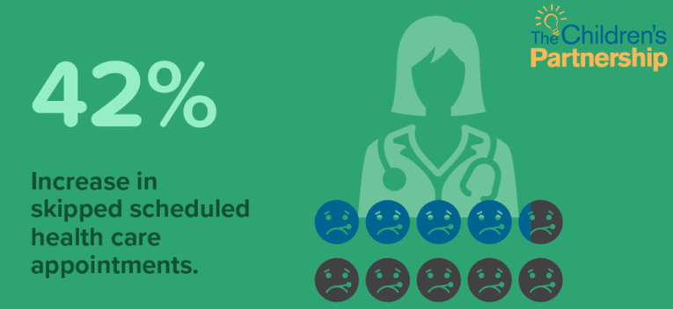
2017: California Provider Survey
“One undocumented parent told me that she was nervous about getting mental health care services because of ‘all the questions we ask,’ referring to the high number of intake forms required for our services.” Health Provider, California

Slide 18
2018 Snapshot: Family Focus Groups
“As a mother, I am worried. It keeps me up at night. Because of the president, Mr. Donald Trump, the kids are learning how to hate.”
-Latino immigrant parent, Riverside
“I am scared that someone wants to remove me from my house... I may be at a store with my children and they arrest me, that is something that worries me.”
-Latino immigrant parent, Fresno
“I mean right now I feel like I live in Third World country. You know like in a camp sometimes the guard comes and catches people and sends them back.”
-API immigrant parent, Fresno
“It’s like hanging from a string that can be cut at any time.” – Young Latino male (16-21), Riverside

Slide 19
Moving Forward: Safe Schools
Passage of AB 699
The role of schools and early learning providers in creating welcoming safe spaces for children in immigrant families
All In For Safe Schools
Coalition to support AB 699 implementation
Training and education
Development of materials

Slide 20
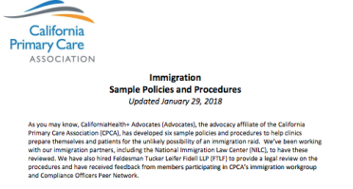
Moving Forward: Building Awareness & Providing Support
Equity Enrollment Strategies
WIC/Medi-Cal ELE
Public education
Up-to-date information
Family-friendly materials
“Know your rights” and safety planning
Individual civic engagement
Role of storytelling

Slide 21
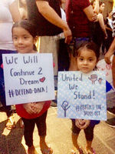
Thank you!
Kristen Golden Testa
ktesta@childrenspartnership.org
213-341-1222
@KidsPartnership

