Slide 1


Modernizing Medicare through Oral Health Advocacy
Marsha Beatty, BS, MPH
Oklahoma Oral Health Coalition and (OOHC)
Oral Health Progress and Equity Network (OPEN) January 23, 2020

Slide 2
Why is this issue so important?
Lack of Readily Available Dental, Hearing and Vision Coverage
Vulnerable Population Groups with Significant Dental, Hearing and Vision Problems!

Slide 3
Many Medicare beneficiaries live on limited, fixed incomes¹:
Additional Coverage
=
Additional Cost
Major
Challenges
with
Inadequate
Medicare
Coverage

Slide 4
Specific Challenges with
Medicare
Coverage for
Oral Health
Dental Coverage
is often
Non-Comprehensive and
Fragmented*.

Slide 5
Specific Opportunities with
Medicare
Coverage for
Oral Health
Oral-Systemic Link:
Good oral health is strongly tied to good overall health².

Slide 6
Specific Opportunities with
Medicare
Coverage for
Oral Health
Oral Health Coverage can lead to significant, overall cost savings in the health care system. ³

Slide 7
Oral Health Coverage Proposal Perspectives
Legislative
Policy
Programmatic

Slide 8
How Do We Get From Here to There?
Advocacy!
Advocacy!!
Advocacy!!!

Slide 9
The Role of Advocacy!
Advocacy is the active pursuit, support or defense of a person, group, plan, cause, proposal or idea.
An advocate works on the behalf of others, either by pleading on their behalf or by supporting their cause through individual or collaborative effort.

Slide 10
Health Advocates in Local Communities:
function as change agents either by directly causing productive and positive change on behalf of others or by empowering others to effect change for themselves.

Slide 11
Selected Forms of Health Advocacy
Research advocacy
Community-based advocacy
Population-based advocacy
Education advocacy
Lobbying

Slide 12
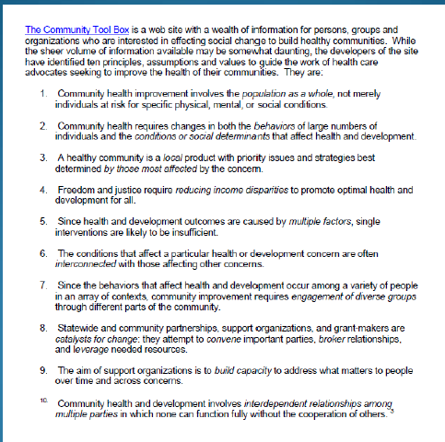
Advocacy in Action:
Ten Principles
https://ctb.ku.edu/en

Slide 13
ADVOCACY TIPS
    Know your issue well.
    Know the relevant rights, rules and regulations.
    Get partners.
    Get help.
    Get a picture of what “better” looks like.
    Recognize and communicate awareness of legitimate interests.
    Link the issue.
    Use emotion appropriately.
https://ctb.ku.edu/en

Slide 14
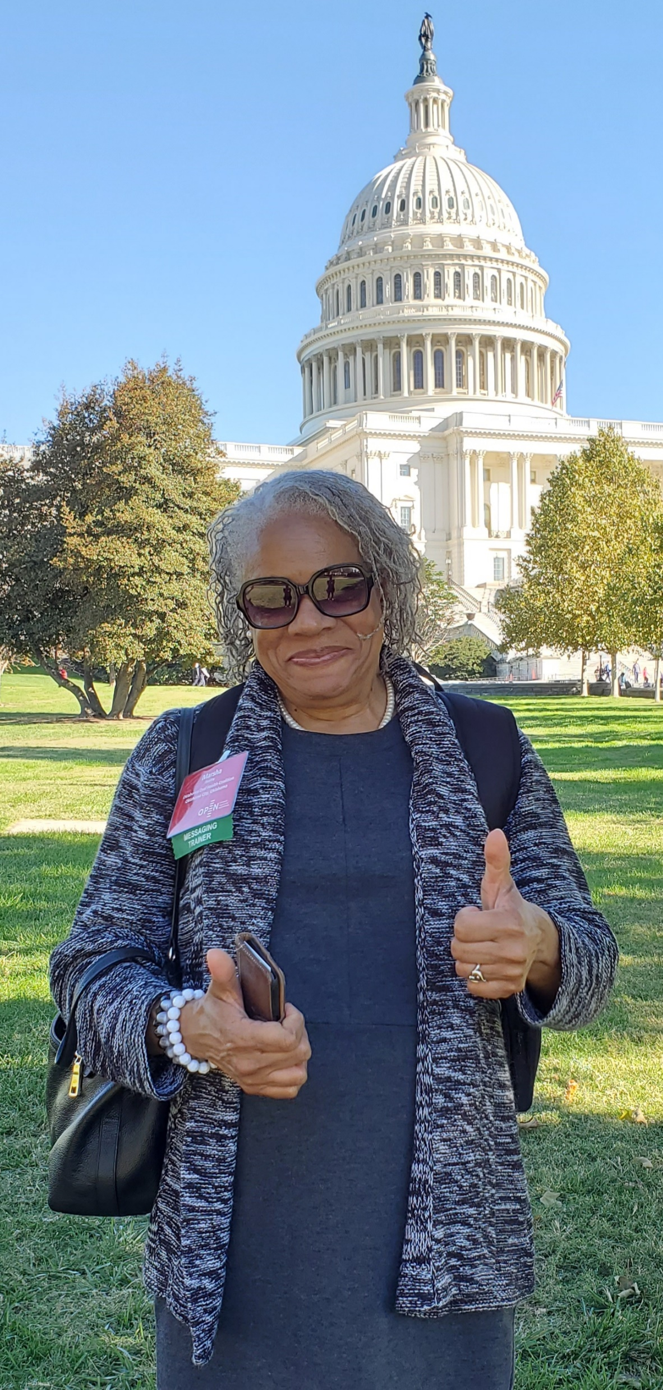
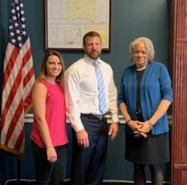

OPEN Capitol Hill Day 10/23/2019!

Slide 15
Robust Preparation was Absolutely Critical!
Advocacy Training and Mentoring
Webinars, Email messages and Phone Calls
Tool Kits and Guides
Issue Briefs and Fact Sheets
Accountability Check-Ins
Affirmations and Encouragement

Slide 17

Phenomenal Advocacy Resources Are Indeed Available!
Access Them And Use Them Wisely!
Advocacy Guides
Advocacy Toolkits
Amicus Briefs
Comments
Fact Sheets
Infographics
Insights Columns
Issue Trackers
Raw Data
Reports
Slideshows
Social Toolkits
Telebriefings
Videos
Webinars

Slide 18

Phenomenal Advocacy Resources Are Indeed Available!
Access Them And Use Them Wisely!
http://www.oralhealth.network/

Slide 19


EVOLUTION OF AN ORAL HEALTH ADVOCATE:
From “Concerned” Health Programs Professional
to
“Savage” Oral Health Advocate!

Slide 20

Hidden Pain: America's Oral Health Crisis
https://youtu.be/4EETIhbiGBI

Slide 21
YOU Can Become an Advocacy “Savage”, TOO!

Slide 22
QUESTIONS?
Marsha Wilkes Beatty, BS, MPH
Assistant Professor of Research; Director, Senior Externship Program and
Chairperson, Diversity and Inclusion Committee
Oklahoma University College of Dentistry
Community Dentistry Division
1201 N. Stonewall Avenue, DCSB Room 564
Oklahoma City, OK 73117
Marsha-Beatty@ouhsc.edu

Slide 23
Endnotes
1. Gretchen Jacobson, Shannon Griffin, Tricia Neuman, and Karen Smith; “Income and Assets of Medicare Beneficiaries, 2016-2035”, Kaiser Family Foundation, April 2017, Accessed January 16, 2020; https://www.kff.org/medicare/issue-brief/income-and-assets-of-medicare-beneficiaries-2016-2035/.
2. Gil-Montoya, José Antonio et al. “Oral health in the elderly patient and its impact on general well-being: a nonsystematic review.” Clinical interventions in aging vol. 10 461-7. 11 Feb. 2015, doi:10.2147/CIA.S54630
3. Griffin SO, Jones JA, Brunson D, Griffin PM, Bailey WD. “Burden of oral disease among older adults and implications for public health priorities”. Am J Public Health. 2012 Mar;102(3):411-8. doi: 10.2105/AJPH.2011.300362. Accessed January 15, 2020; https://www.ncbi.nlm.nih.gov/pmc/articles/PMC3487659/

