Slide 1
Envisioning Universal Health Care
January 23, 2020
Notes:
NOTE: Make sure that the Title slide does not have footer information (sources, FUSA logomark and page number). To turn off on this page, go to Insert > Headers&Footers and deselect Footer and Page number options > Apply to this page only. Also, select start page numbers at 0.

Slide 2
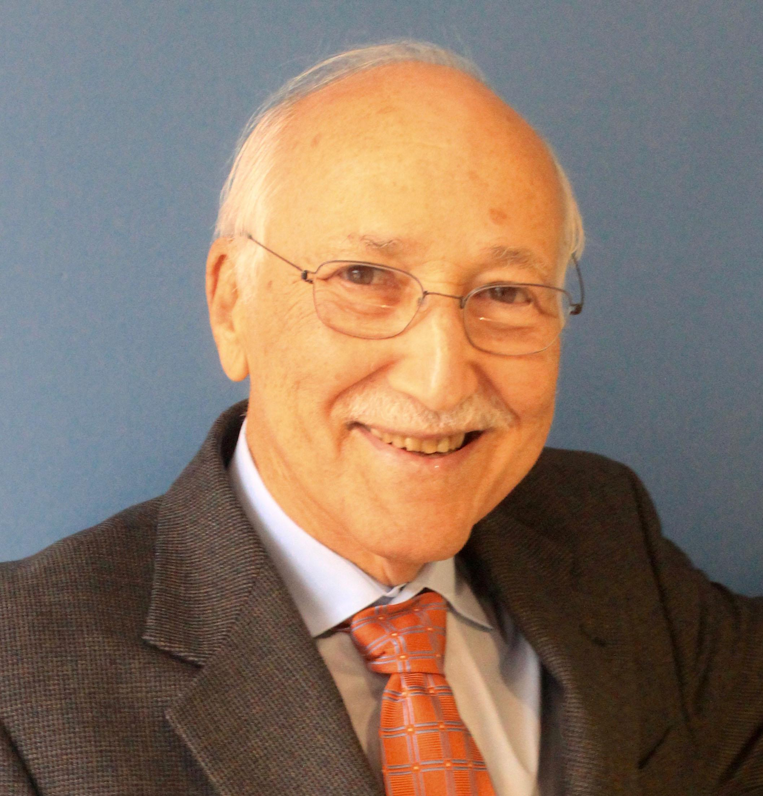
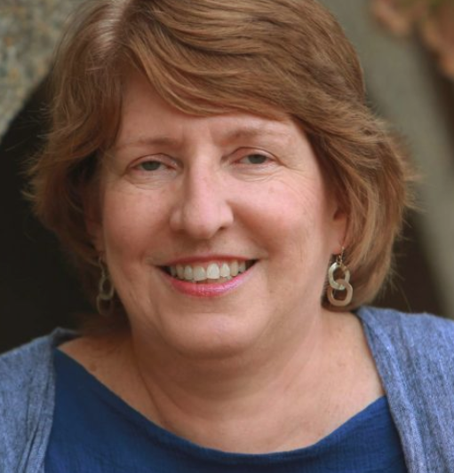
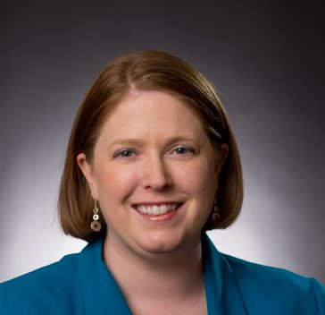
Introductions
Philippe Villers, President, Families USA
Jill Zorn, MBA, Senior Policy Officer, Universal Health Care Foundation of Connecticut
Jen Bersdale, MNM, Executive Director, Missouri Health Care for All
Sanjeev Sriram, Policy Advisor, All Means All at Social Security Works.

