Slide 1
Families USA Health Action Conference Children’s Cabinets
Sandra Wilkniss
January 24, 2020
Washington, DC

Slide 2
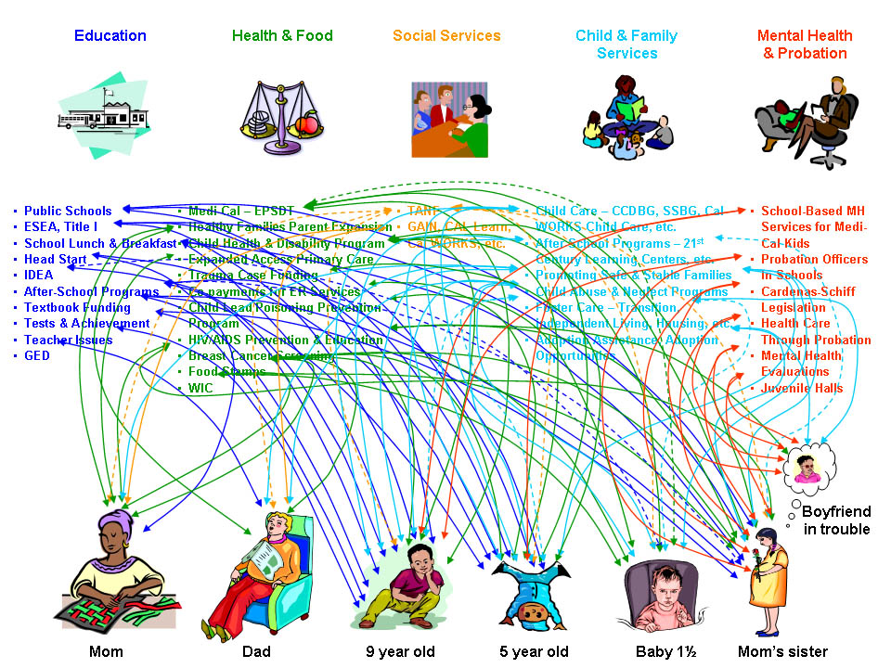
A fragmented set of supports via siloed policies and programs:
Source: Elizabeth Gaines/Margaret Dunkle, Forum for Youth Investment; Children’s Funding Project
Notes:
Typical response is See a Problem, Convene a Task Force, Create a Program

Slide 3
Ready by 21 - challenging leaders to think differently & act differently…
Moving the small gear makes a BIG difference

Slide 4
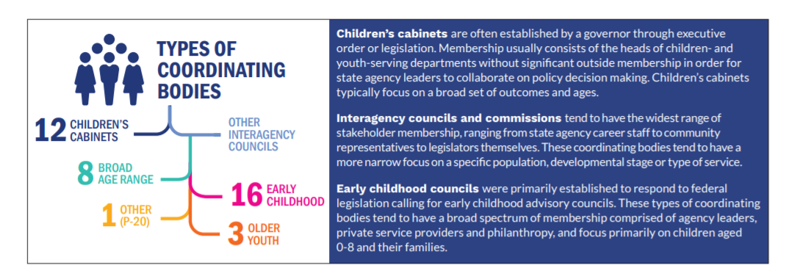
Children’s Cabinets around the Country
From the last 2017 survey – Forum for Youth Investment:
[https://forumfyi.org/ccn/state/]

Slide 5
Children’s Cabinets – Key Features for Success
Align policies, programming and funding to drive toward common goals
Sustainability through core set of indicators and outcomes
Clear plan to collaborate with all levels of government
and support local governments and key stakeholders
Youth and families play an important advisory role

Slide 6
Thank you!
Sandra Wilkniss
National Governors Association
Center for Best Practices, Health
swilkniss@nga.org
Notes:
Thank you to RWJF for supporting meeting – remarks from Giridhar?

