Slide 1



All Means ALL
Racial Equity and Health Justice
Sanjeev K. Sriram, MD, MPH
@DrAmericaShow
@DrSriram
@dramerica_allmeansall
Notes:
Sanjeev K. Sriram, MD, MPH
“Dr America” for We Act Radio, physician, and health justice activist

Slide 2
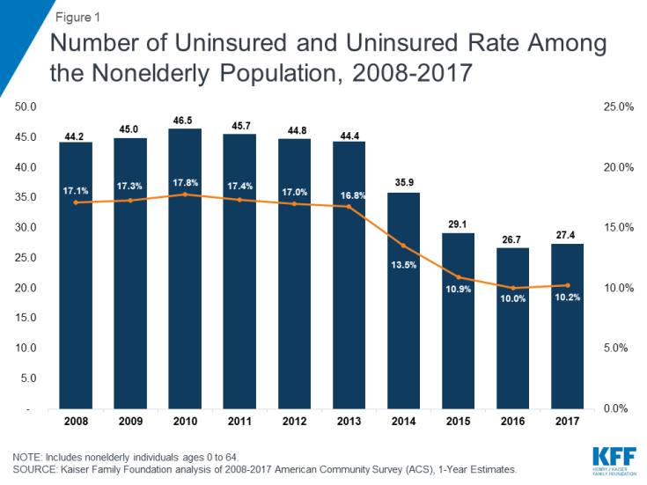
Progress made by the ACA

Slide 3
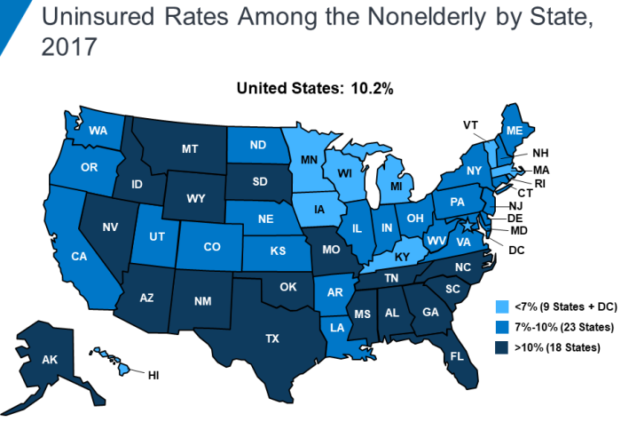
Progress made by the ACA
Notes:
https://www.kff.org/uninsured/fact-sheet/key-facts-about-the-uninsured-population/

Slide 4
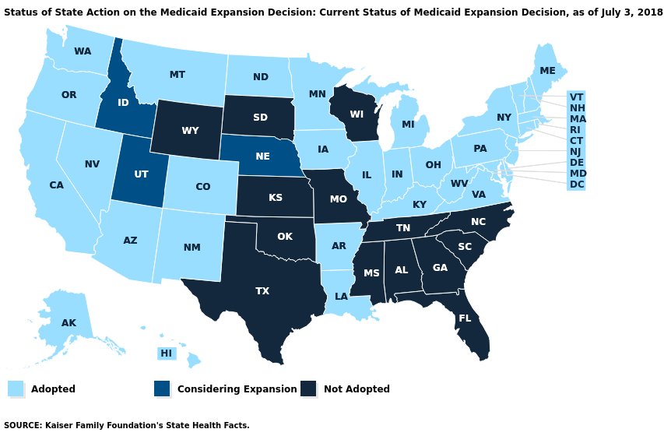
Progress made by the ACA

Slide 5
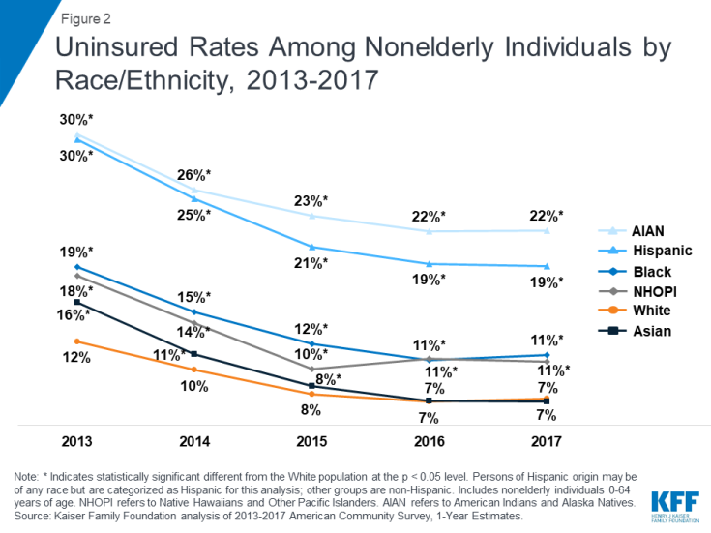
Progress made by the ACA
Notes:
https://www.kff.org/disparities-policy/issue-brief/changes-in-health-coverage-by-race-and-ethnicity-since-implementation-of-the-aca-2013-2017/

Slide 6
59% of the 28 million uninsured are people of color

Slide 7
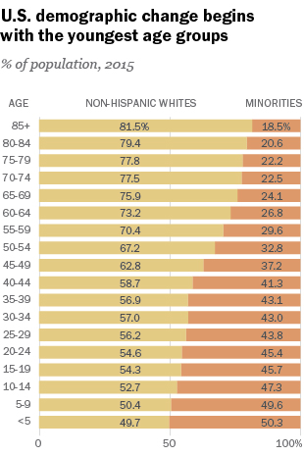
People of Color: Majority in 2040 NOW
2011: 50.4% of infants (< 1yr) are POC
2011: under age-10 POC are majority in 13 states (HI, CA, NV, AZ, NM, TX, NY, NJ, MD, DC, FL, GA, MS)
2014-15 school year: POC enrollment in public schools > whites
2018: POC are majority in HI, CA, NV, NM, TX, DC, PR (MD at 49.5%)
2020: over half of US children < 18yr will be POC
Notes:
https://www.npr.org/sections/ed/2016/07/01/484325664/babies-of-color-are-now-the-majority-census-says

Slide 8
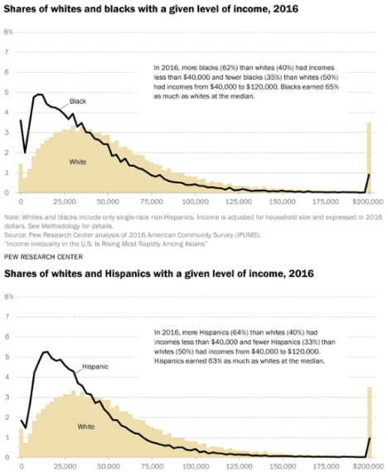
Income Inequality & Racial Inequality
62% of Blacks and 64% of Latinx earn less than $40,000 compared to 40% of Whites
35% of Blacks and 33% of Latinx have incomes from $40,000 to $120,000 compared to 50% of Whites
69% of Americans do not have $1,000 in savings
40% of Americans do not have $400 for an emergency
Notes:
https://www.pewsocialtrends.org/2018/07/12/appendix-a-income-distributions-of-whites-blacks-hispanics-and-asians-in-the-u-s-1970-and-2016/

Slide 9
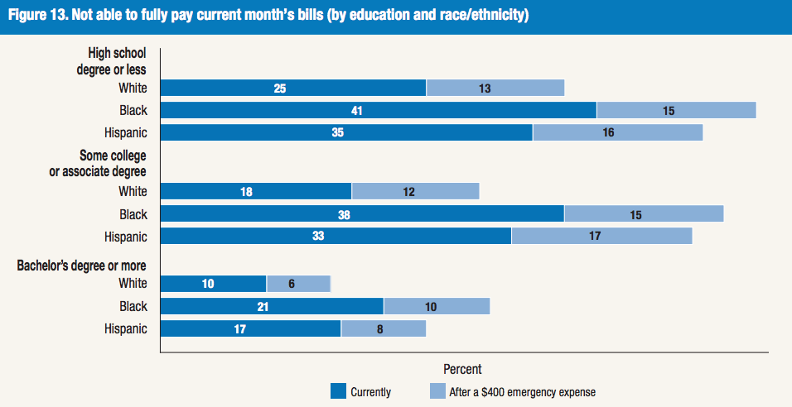
The Pain of a $400 Emergency…
Notes:
https://www.federalreserve.gov/publications/files/2017-report-economic-well-being-us-households-201805.pdf

Slide 10
NOW is the time for Medicare For All
Why the ACA is important but insufficient:
  Medicaid can work wonders – depending on where you live
  Private insurance is unreliable
  The current fragmented system is inefficient, unjust, unsustainable, and unrealistic
2017 Pew Research: 85% of Blacks and 84% of Latinx say the government should ensure health coverage
NOW is the time to make racial equity a cornerstone, not a side project or after-thought, of health policy.
Notes:
http://www.pewresearch.org/fact-tank/2017/01/13/more-americans-say-government-should-ensure-health-care-coverage/

Slide 11
59% of the 28 million uninsured are people of color

Slide 12
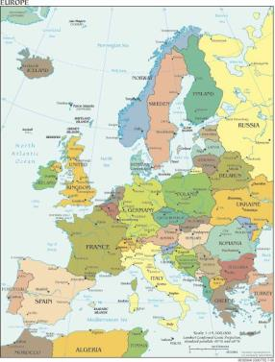



Medicare For ALL?
What’s said about MFA:
How that’s heard:

Slide 13
Medicare For All will help POC
With MFA, health care is a human right no matter what you earn, where you live, or what you look like.
The coverage moves with you for life: job to job, state to state, graduation, retirement, etc.
Community hospitals and clinics will have more reliable funding to stay open with high quality staff and resources.
More support for health care in under-served and rural communities.
In S 1129 and HR 1384, there will be funding to build and maintain racial equity across hospitals and clinics.
MFA will not end all racism in health care. The policies help but are not a cure-all.

Slide 14
All Means All
As we build Medicare for All, we must engage minority communities who have been overlooked or under-prioritized
Center MFA on racial justice and eliminating health inequities
Multi-lateral approaches:
  Engage and energize our communities
  Motivate academic medicine & public health
  Push members of Congress & 2020 candidates
  Educate, organize, & agitate on social media
    #Medicare4All #MedicareForAll #AllMeansAll
Learn more at www.socialsecurityworks.org/allmeansall
@DrAmericaShow
@DrSriram
@dramerica_allmeansall

