Slide 1
Health4ALl: a brief Campaign History

Slide 2
who is a Californian? Inclusion OF Our state’s Undocumented residents
2.9 million Californians
Parents of more than 1 in 6 kids
1 in 11 workers
Pay $3.2 billion/year in state & local taxes
A critical part of our economy and social fabric, yet locked out of the safety net

Slide 3
Injustice in the Safety Net
Medi-Cal: CA’s Medicaid program since 1966
State-funded coverage for some immigrant populations who are not covered through federal Medicaid dollars
Many low-income immigrants are excluded except emergencies & pregnancies
Notes:
Expansion of income threshold
138% FPL for adults under 65
213% for pregnant women
266% for children
PRUCOL = Asylum seekers, DACA, U/T visa applicants & holders
Doesn’t include non-immigrant visa holders

Slide 4
Health4AlL: Beginnings
Coalition created in 2014; co-chaired by CIPC and Health Access CA
Legislation first introduced by Sen. Ricardo Lara in 2014
Proposal included Medi-Cal expansion to all, regardless of status
Ultimately died in committee

Slide 5
Health4AlL KIDS WIN
2015: Sen. Lara re-introduces the same proposal, which gets amended and passed:
Medi-Cal expansion only for children through age 18
“Health4All Kids” goes into effect May 2016

Slide 6
Health4All in the individual marketplace
2015: Sen. Lara also introduces proposal directing the state to apply for a federal 1332 ACA State Innovation waiver allowing undocumented Californians and DACA recipients to purchase unsubsidized coverage through Covered California
Sept. 2016: application submitted by Covered California
Nov. 2016: Presidential election occurs
Jan. 2017: state rescinds 1332 waiver due to unlikelihood of approval by Trump administration and concerns over undocumented consumer privacy protection

Slide 7
2017-2018: The Push for Health4All Young Adults & Seniors begins
Senate and Assembly bills began as identical bills proposing expansion to all adults
Eventually amended to elders ages 65+ & young adults ages19-25, driven by directly impacted community members saying “our elders first”
Senate & Assembly supported the investments but ultimately unsuccessful in final budget negotiations with Gov. Brown
Notes:
Up to age 26: on par with ACA provision allowing children to remain on parents’ plan as well as Medicaid eligibility at children’s income threshold for foster youth
Also prevents 19-year-olds from aging out

Slide 8
2019: Health4All Young Adults
Governor Gavin Newsom, who campaigned on single-payer, includes a proposed Medi-Cal expansion for young adults (19-25) regardless of status in his preliminary budget
Legislature supports; it passes
Advocates also advance proposal for both young adults & seniors (65+) but does not pass

Slide 9
2020: Health4All Elders… hopefully!
Jan. 10th, 2020: Governor Newsom includes a proposed Medi-Cal expansion for seniors, regardless of status, in his preliminary budget

Slide 10
Health4All in California: How we gOt here
Co-chairs: immigrant rights and health advocates
Large, diverse coalition prepared to mobilize
Empowerment of directly impacted individuals
Effective legislative champion(s)
Data from researchers (e.g. Towards Universal Health Coverage by Laurel Lucia, UC Berkeley)
Communications strategy to shape public narrative

Slide 11
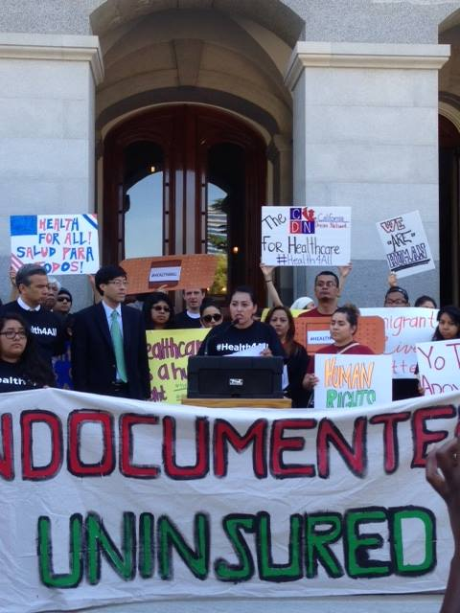
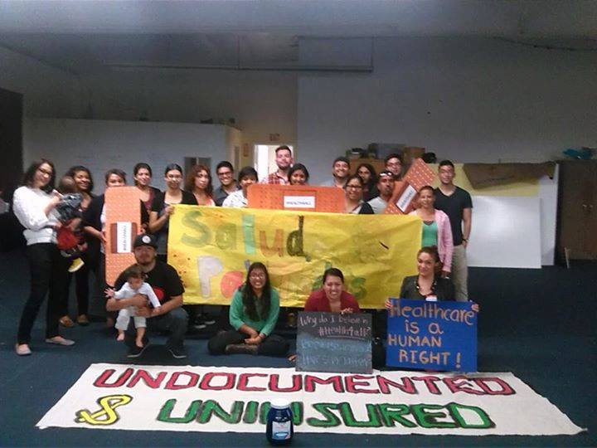
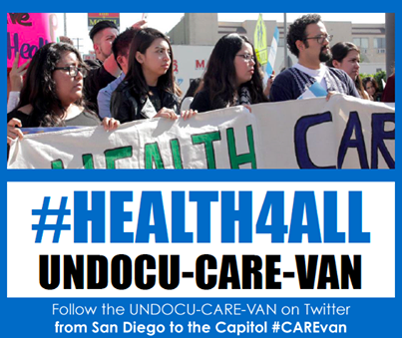
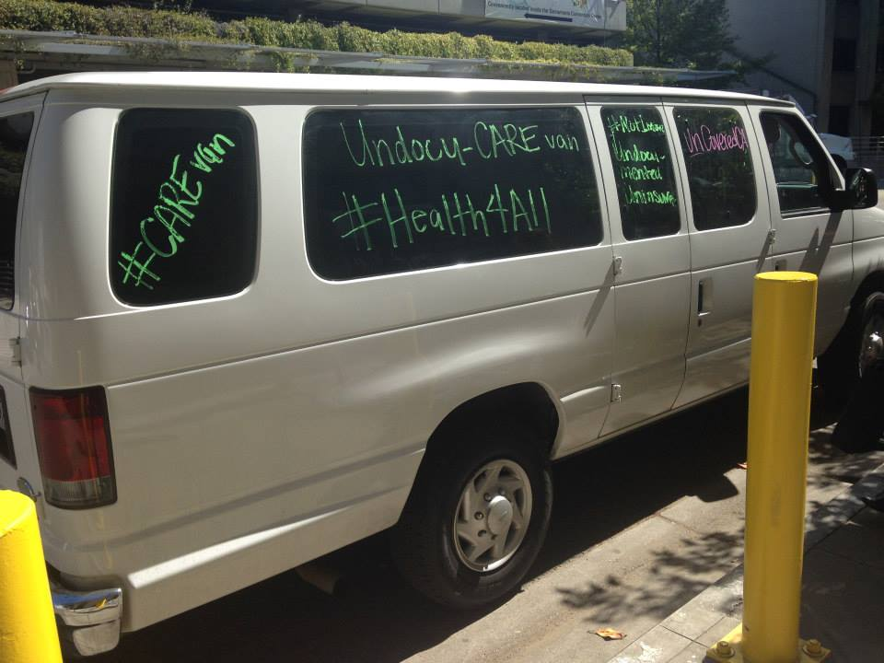
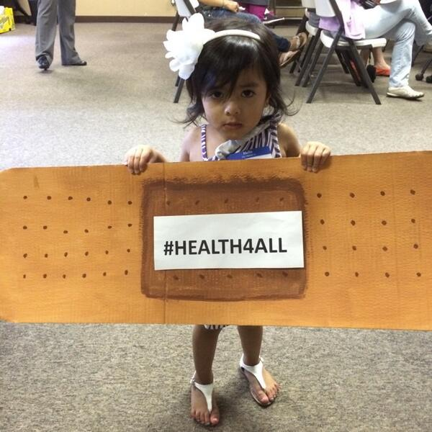
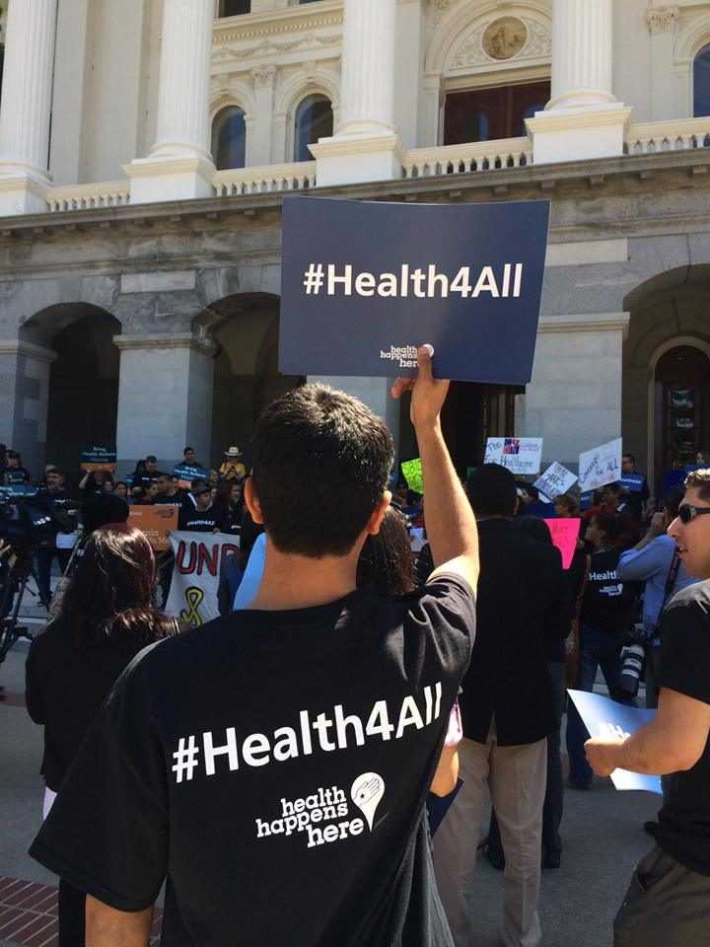
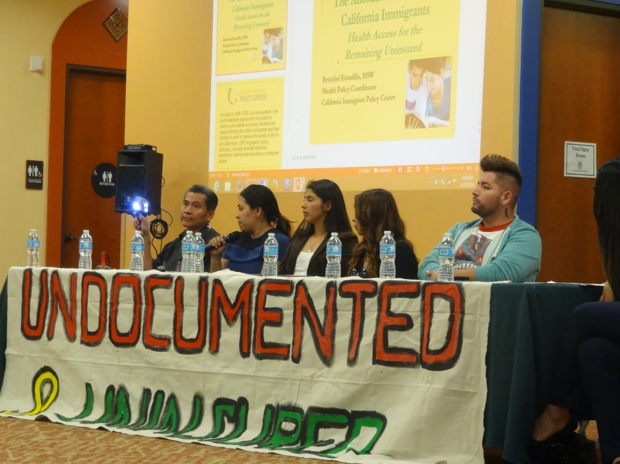
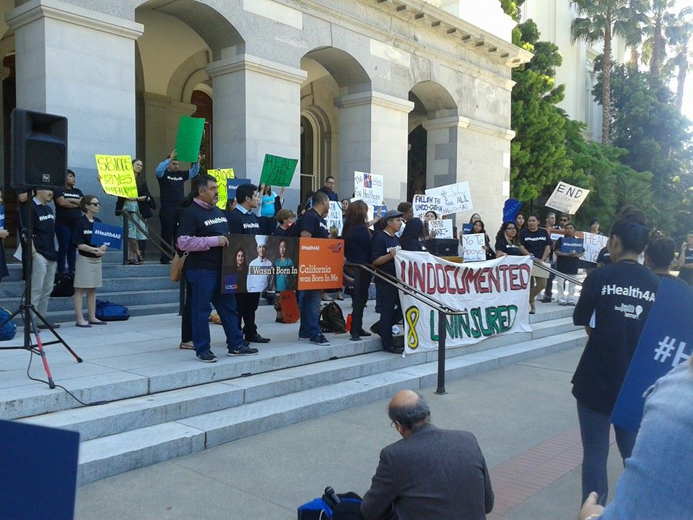

Slide 12
Contact US
CAimmigrant.org
Sarah Dar, MPH Senior Policy Manager, Health & Public Benefits sdar@caimmigrant.org
(213) 250–0880 ext. 106

