Slide 1
Stopping surprise medical bills in Texas
Stacey Pogue
Senior Policy Analyst, Pogue@cppp.org
January 23, 2020

Slide 2
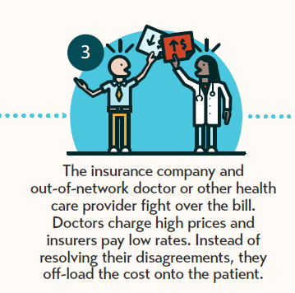
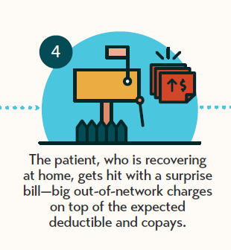
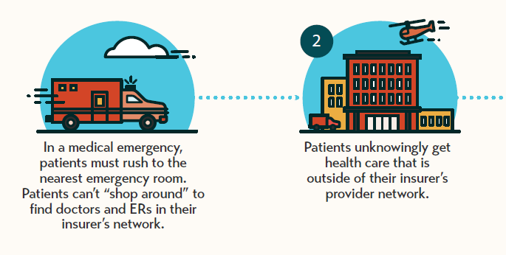

Slide 3
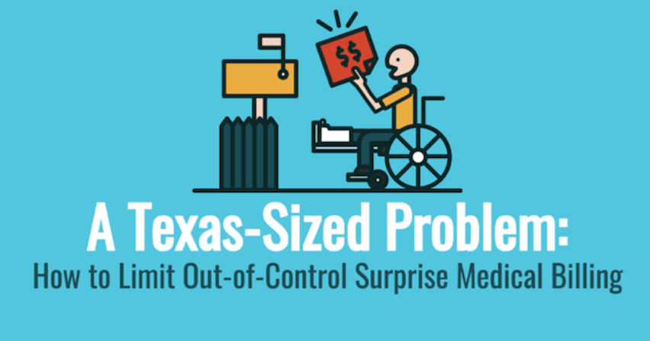
Overview of policy changes in Texas
2009: Texas passes first-in-the-nation dispute resolution system for surprise medical bills.
Does not fully protect consumers. Consumers still trapped in the middle of fights over prices. Few consumers benefit.
2015: Texas consumer groups first introduce bill to stop surprise medical bills in Texas. Other stakeholders neutral or opposed
2015 and 2017: Passed incremental improvements to Texas’ mediation system.
2019: Passed strong bill that fully protects consumers. Modeled on New York, but with some improvements. Supported by most stakeholder groups.

Slide 4
Texas Ban on Surprise Medical Billing
Applies to:
PPOs
HMOs
EPOs
State employees
School district plans
Health care:
Emergency (not ambulance)
Out-of-network doctor at in-network facility
Lab/imaging connected to in-network doc
Patient pays:
Copay, coinsurance or deductible, as if care had been in-network. No extra charges after dispute resolution
Payment and dispute resolution:
No billing or payment thresholds
Mediation (agreement) for facilities
Arbitration (winner and loser) for docs. Data points:
80th percentile of charges
Median in-network rate
State regulated
Senate Bill 1264, 86th Regular Session, 2019

Slide 5
Strategies: Media
Frequent news coverage keeps pressure on lawmakers. Examples:
a lab billed a Texan $17,000 to test a urine sample;
an $8,000 bill from an emergency even after the patient checked that the emergency room was in-network;
$109,000 bill following a heart attack; and
a $56,000 air ambulance ride.
Photo: Michael Ciaglo | Houston Chronicle

Slide 6
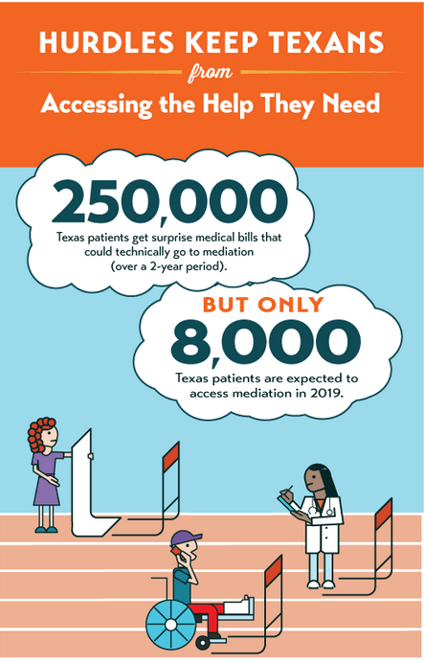
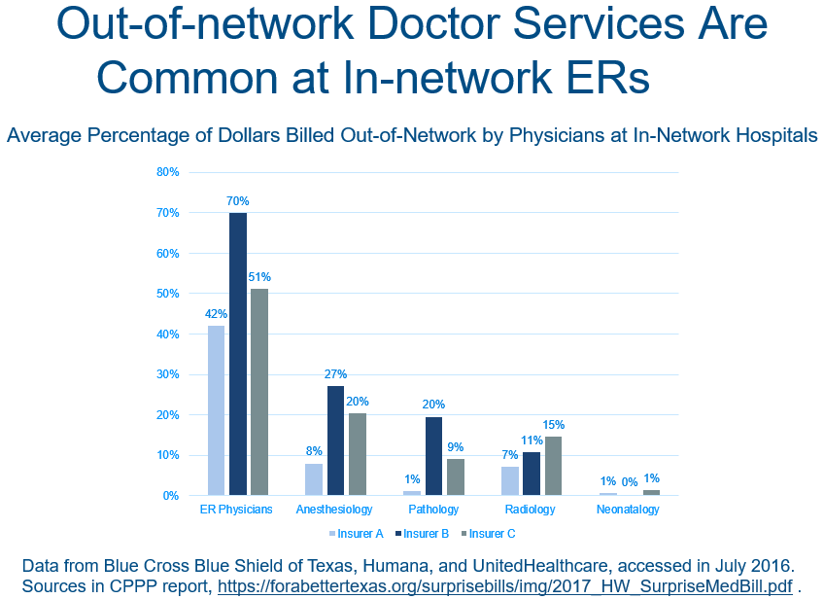
Strategies: Data
The problem is worse in Texas. Research shows that, nationally, 20 percent of patients admitted to the hospital through the emergency room were likely to get a surprise medical bill. In Texas, the rate is much higher — 34 percent.

Slide 7
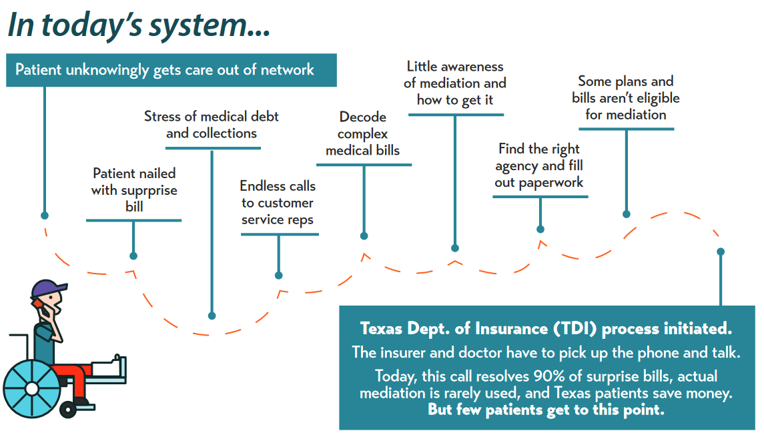
Other Strategies
Texas coalition
Focus on how the system fails consumers
Messaging that works in a conservative state

Slide 8
Lessons
Positions from national associations are known. May help you build your state coalition.
Insurers may be your allies. You may have disagreements with providers.
Industry stakeholders do not agree on solutions. You need strong champions (plural).
Approach can be bipartisan.
It may take more than one session. Keep educating members between sessions.
Identify the consumer group(s) that can lead on payment standards/benchmarks. Consumers need a voice in that fight.
Create simple messages on payment rates that all consumer/patient groups can use:
Any payment standard shouldn’t drive up health care costs.
Don’t solve one problem for consumers, but create another.

Slide 9
We believe in a Texas
that offers everyone the chance to compete and succeed in life.
We envision a Texas
where everyone is healthy, well-educated, and financially secure.
@CPPP_TX

