Slide 1
What's Next? Coverage and Affordability Opportunities in Red, Blue, and Purple States
Stan Dorn, Director, National Center for Coverage Innovation at Families USA
Notes:
NOTE: Make sure that the Title slide does not have footer information (sources, FUSA logomark and page number). To turn off on this page, go to Insert > Headers&Footers and deselect Footer and Page number options > Apply to this page only. Also, select start page numbers at 0.

Slide 2
Topics
Health insurance tax
The strangeness of silver

Slide 3
Health Insurance Tax (HIT)
$15.5 billion in annual revenue, helped fund the ACA
Roughly 1.7% of premiums, nationally
HIT goes away on 1/1/21
By creating a state-level HIT on carriers within the state, a state can
Capture revenue, without raising taxes on insurers above prior levels
Use the money to improve affordability of coverage in the individual market. MD: SB 124, HB 196 combines
Reinsurance
Additional affordability aid
State can’t tax all insurance premiums
Medicare plans, federal employee/retiree coverage
Self-insured employer plans
A state can get revenue from continuing the HIT on
Medicaid Managed Care Organizations (MCOs)
Individual market
Fully insured group market
Estimating state revenue
Insurer rate filings
Oliver Wyman per capita estimates, https://health.oliverwyman.com/content/dam/oliver-wyman/blog/hls/featured-images/August18/Insurer-Fees-Report-2018.pdf

Slide 4
State-accessible money
Medicaid MCOs
State share
Federal share
Individual market
If draw down premium tax credits (PTCs), it’s a money machine for insurers
Group market
Good to have broad revenue base
Can be politically challenging. How to overcome?
Same carriers
Use some of the money to help small employers
Seek federal permission to exclude
Federal legal constraint: Medicaid provider tax laws
Broad-based and uniform
Potential fall-back – just tax individual market

Slide 5
States can capture $11 billion a year
Source: Oliver Wyman August 2018

Slide 6
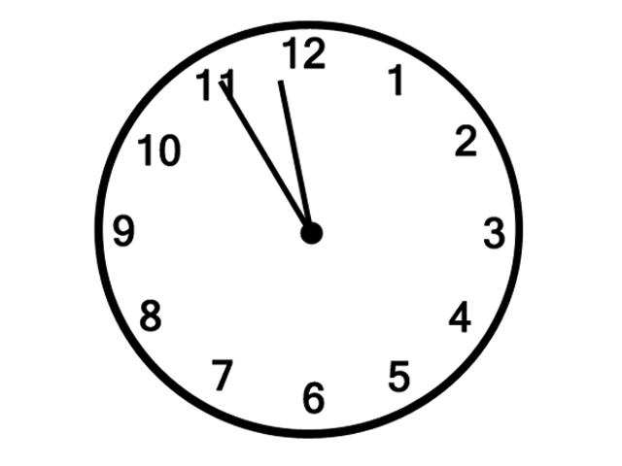

Slide 7
Topics
Health insurance tax
The strangeness of silver

Slide 8
Silver qualified health plan (QHP) premiums are unique
All other premiums make sense: lower premiums = lower costs for consumers
Silver QHP premiums determine the amount of help consumers get under the federal tax code, through premium tax credits (PTCs) under the ACA. For PTC beneficiaries, lower silver QHP premiums can mean
Less financial help, hence
Higher net premium costs

Slide 9
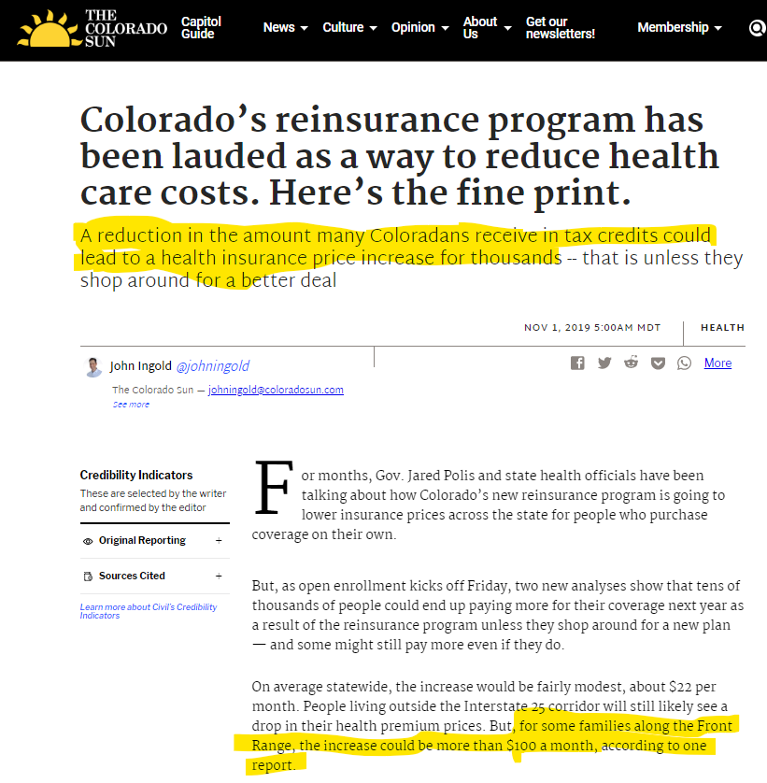

Slide 10
The mechanics
People typically qualify for PTCs with income between 100 and 400% of the federal poverty level
At each FPL percentage, the consumer’s income-based premium contribution for the benchmark plan – i.e., the second-lowest-cost silver plan – is a specified percentage of household income
PTC amount =
premium for benchmark plan –
consumer’s income-based premium contribution.
PTC amount does not change if the consumer picks a different plan. So
Pick a plan $10 > benchmark, pay income-based benchmark contribution + $10
Pick a plan $10 < benchmark, pay income-based benchmark contribution - $10

Slide 11
An example: three 40-year-old single adults
 | Fred | Frances | Franklin
Annual income | $80,000 | $31,225 | $31,225
PTC eligible? | No | Yes | Yes
Plan | Benchmark | Benchmark | Lowest-cost bronze
Sticker-price premium | $462 | $462 | $331
Consumer payment | $462 | $162 (income- based amount) | $85 (331-246=85)
PTC | $0 | $246 (Benchmark – income-based amount) | $246

Slide 12
An example: three 40-year-old single adults
 | Fred | Frances | Franklin
Annual income | $80,000 | $31,225 | $31,225
PTC eligible? | No | Yes | Yes
Plan | Benchmark | Benchmark | Lowest-cost bronze
Sticker-price premium | $462 | $462 | $331
Consumer payment | $462 | $162 (income- based amount) | $85 (331-246=85)
PTC | $0 | $246 (Benchmark – income-based amount) | $246
Sticker-price premiums, 25% drop | $347 | $347 | $248
PTC | $0 | $131 (Benchmark – income-based amount) | $131
Consumer payment | $347 – 25% less | $162 – unchanged | $117 – 38% more (248 – 131 = 117)

Slide 13
Key lesson: Policymakers need to treat silver QHP premiums as different from all other premiums
An across-the-board premium drop
Helps people who are buy insurance without a PTC – 31% of individual-market enrollees
May not help and may even harm people who buy insurance with a PTC – 69% of individual-market enrollees
Ideal configuration to make coverage affordable
Large gap between lowest-cost and second-lowest-cost silver offered on the exchange
Lets consumers <200% FPL enroll in high-value silver, with little or no net premium cost
Relatively high premium for second-lowest-cost silver offered on the exchange
Relatively low gold premiums – if possible, below benchmark premiums
Lets consumers >200% FPL enroll in gold for less than the net cost of benchmark coverage
Relatively low bronze premiums to make zero-net-premium coverage available
4.7 million uninsured are now offered bronze coverage with premiums at or below PTC amounts. Lower bronze premiums would increase that number.
Increased offerings of $0-net-premium bronze leads to increased enrollment among low-income consumers

