Slide 1
You Can’t Measure What You Don’t Plan: Mapping Out Your Strategic Communications Journey
Kimberly N. Alleyne, Lisa R. Holland,
Adina Marx
Notes:
NOTE: Make sure that the Title slide does not have footer information (sources, FUSA logomark and page number). To turn off on this page, go to Insert > Headers&Footers and deselect Footer and Page number options > Apply to this page only. Also, select start page numbers at 0.

Slide 2
RPIE
Research Planning Implementation Evaluation

Slide 3
Research

Slide 4
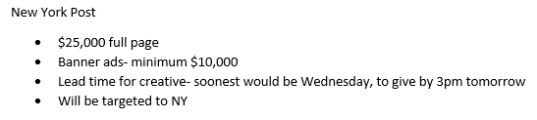
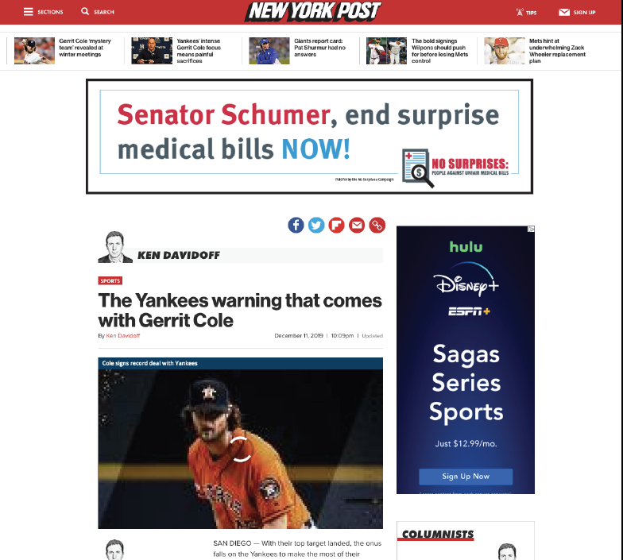
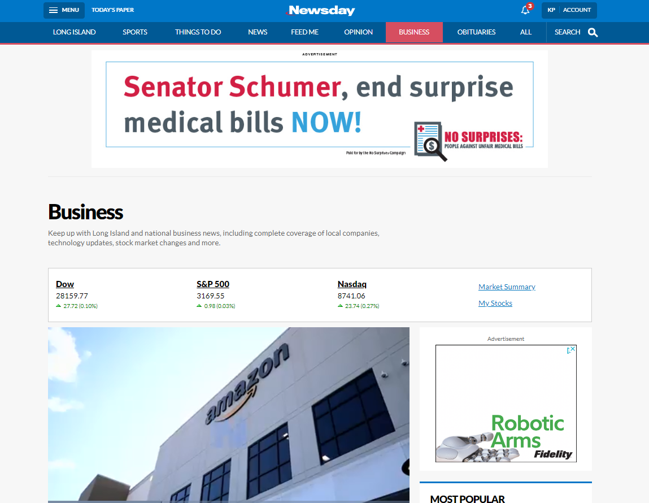
Ads for No Surprises Campaign

Slide 5
Planning

Slide 6
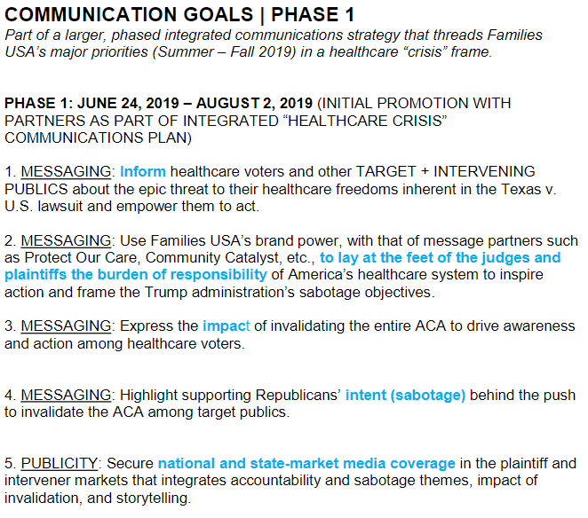
Communications Plan: Health Care Repeal Lawsuit

Slide 7
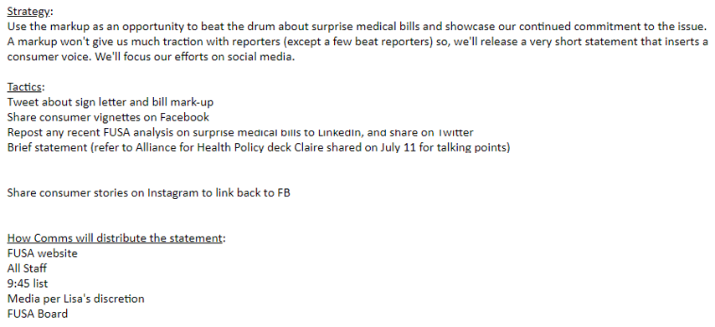
Communications Tactical Plan: Surprise Medical Bills

Slide 8
Implementation

Slide 9
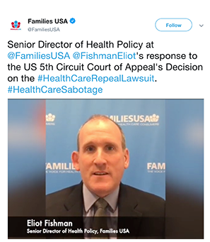
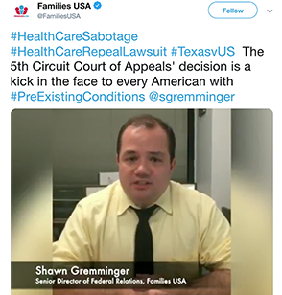
Implementation: Health Care Repeal Lawsuit

Slide 10

Implementation: Health Care Repeal Lawsuit

Slide 11

Implementation: Surprise Medical Bills

Slide 12
Evaluation

Slide 13
Factors for Effective Evaluation
Did you accomplish your objectives?
Were you able to get key messages out and heard?
Measure effectives of the program against its objectives.
Identify ways to improve and recommendations for the future.
Adjust the plan, materials, etc., before going forward

Slide 14
Why do digital ads?
Digital ads allow us to target specific demographics for the content we want them to see.
For small organizations, who may not have the resources their opponents do, digital advertising is an essential tool in getting your message out in an increasingly crowded bazaar of content.

Slide 15
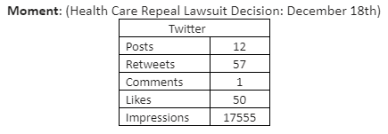
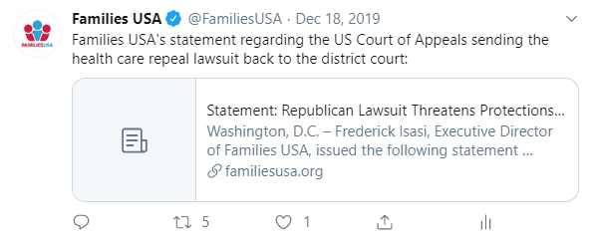
Organic Posts for Health Care Repeal Lawsuit

Slide 16
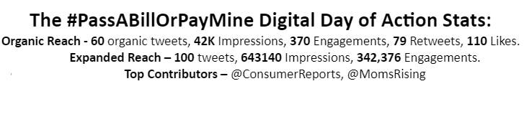
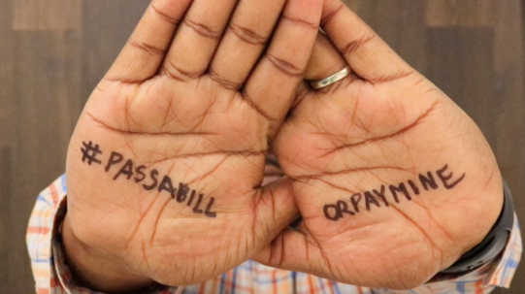
#PassABillOrPayMine Digital Ads

Slide 17
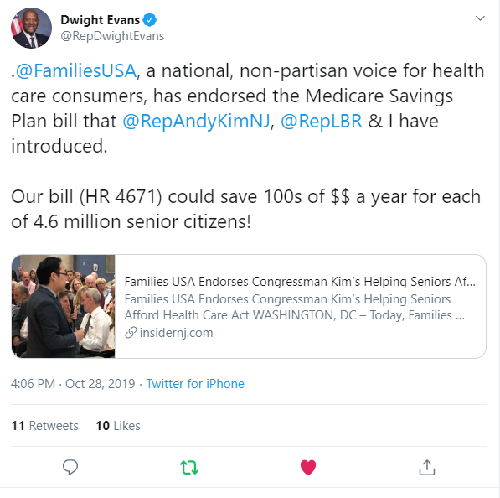
Engagements with Leadership

Slide 18
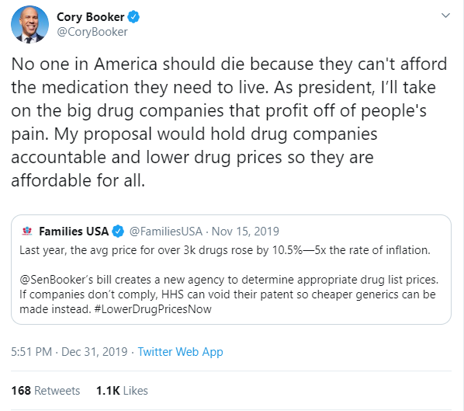
Engagements with Leadership

Slide 19
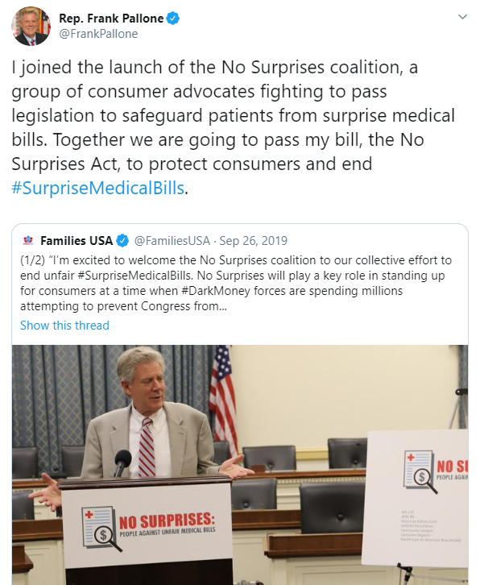
Engagements with Leadership

Slide 20

Engagements with Leadership

Slide 21
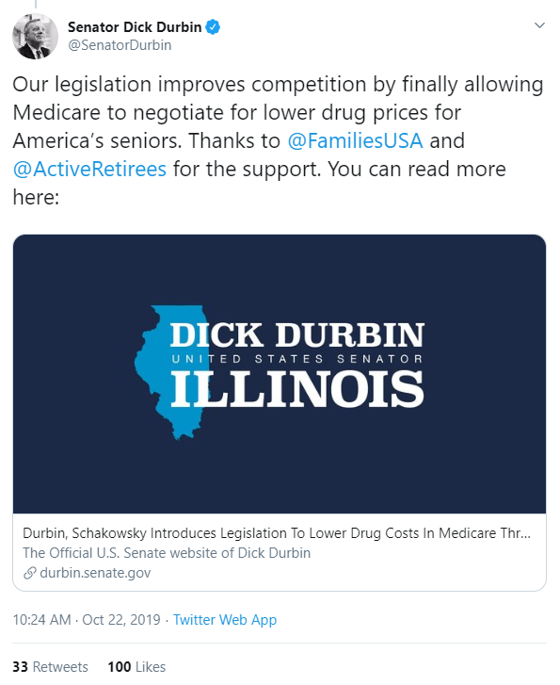
Engagements with Leadership

Slide 22
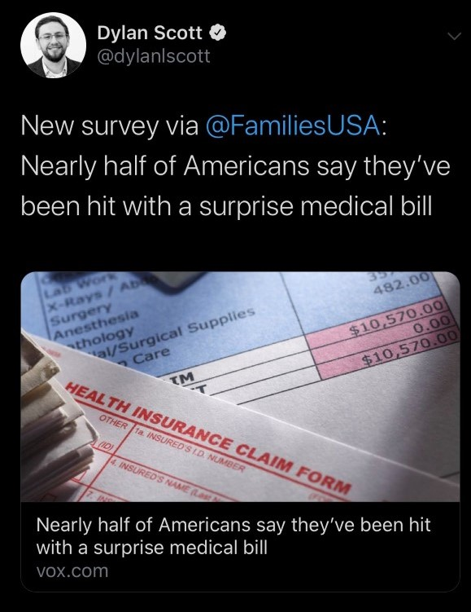
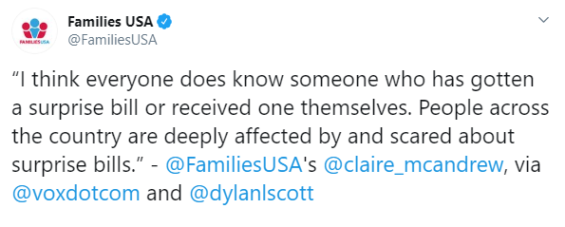
Engagements with Reporters

Slide 23
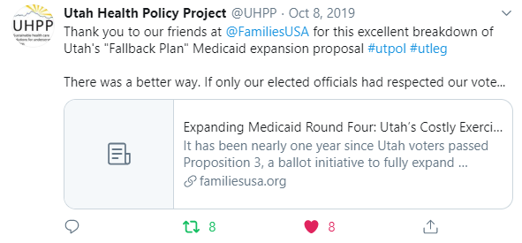
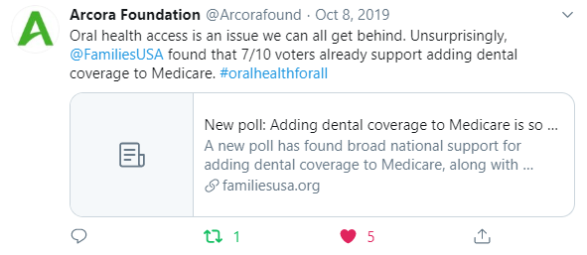
Engagements with Partners

Slide 24
Exercise: Think about an upcoming project at your organization. How would you evaluate your work on it? Or how would you reevaluate a project you completed?

Slide 25

Thank you for coming!
Any questions? Want to keep in touch?
KAlleyne@FamiliesUSA.org
@KimAlleyne
LHolland@FamiliesUSA.org
@commsmediapr
AMarx@FamiliesUSA.org

