Slide 1
Affordability and Coverage in State Individual Markets: Time-Sensitive Opportunities
Moderated by Stan Dorn
Director of National Center for Coverage Innovation at Families USA
March 2, 2020
Notes:
NOTE: Make sure that the Title slide does not have footer information (sources, FUSA logomark and page number). To turn off on this page, go to Insert > Headers&Footers and deselect Footer and Page number options > Apply to this page only. Also, select start page numbers at 0.

Slide 2
Special guest stars
Colin Baillio
Director of Policy and Communications,
Health Action New Mexico
Greg Fann
Consulting Actuary, Axene Health Partners, LLC
John-Pierre Cardenas
Health Policy Adviser, former Policy Director, Maryland Health Benefits Exchange

Slide 3
Topical overview
1. Health insurance assessments
2. Metal-level premium alignment
3. Q&A (chat function)

Slide 4
Health Insurance Assessment (HIA)
The federal “Health Insurance Provider Fee” originally helped fund the Affordable Care Act (ACA)
Temporarily suspended in 2017 and 2019
In 2019, MD and DE created state HIAs to capture the revenue being abandoned by the federal government.
Used the money to finance reinsurance. Insurance industry supportive. Didn’t raise their assessment, helped both insurers and consumers.
Federal HIA now in effect. Baked into insurers’ 2020 rates. > $15 billion!
December omnibus federal legislation phased out the federal HIA, effective 1/1/2021. States that pass legislation in 2020, effective 1/1/2021, can:
Lower health care costs for state residents, addressing severe affordability challenges, without raising taxes or otherwise increasing state costs.
Create a state HIA that takes the money the state’s insurers have been sending to Washington, DC, brings it back to the state, and uses it to make insurance more affordable to state residents.
Make sure the insurance industry isn’t asked to pay more than they pay today.
Prevents well-heeled insurers from capturing another federal tax windfall.
The state HIA –unlike the federal HIA – can be targeted to specific purposes that benefit carriers, small employers, and consumers. Creates possible win-win solution.

Slide 5
Inside the federal HIA machinery
IRS sets total annual target amount, which is divided among carriers based on their total, national premium revenue
Markets assessed
Individual market
Small group market
Fully-insured large group market
Medicaid managed care organizations (MCOs)
Medicare plans
Federal employee and retiree insurance
Assessment not a deductible business expense. So increased premiums that pay the assessment count as taxable revenue.
For-profit carriers raise premium charges to account, not just for the HIA fee itself, but also for the associated increase in federal tax liability
Exemptions
For each affected insurer’s national book of business:
Premiums < $25M not assessed.
Premiums $25M-$50M assessed at half of HIA levels
Nonprofit insurers that get 80% of revenue from Medicare, Medicaid, and CHIP are exempt
Other nonprofit insurers assessed at half of HIA levels

Slide 19
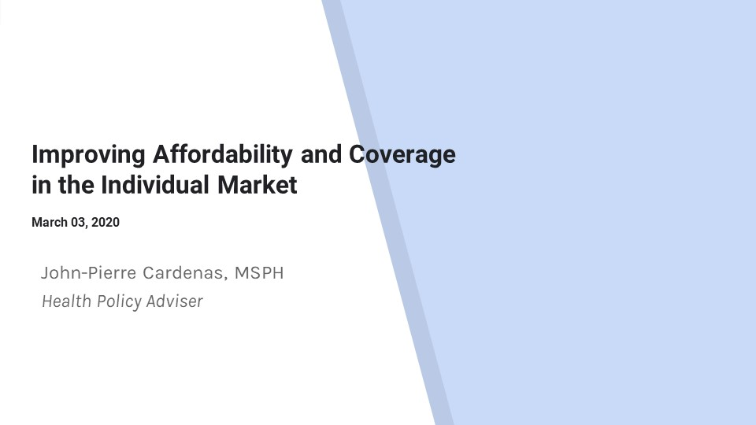

Slide 25
Metal-level premium misalignment
“Actuarial value” or AV: the percentage of covered claims the insurer would pay for a standard population
Metal level |  | AV | Average deductible in healthcare.gov
Bronze |  | 60% | $6,506
Silver
 | Base | 70% | $4,544
 | With CSRs for people 200-250% FPL | 73% | $3,268
 | With CSRs for people 150-200% FPL | 87% | $762
 | With CSRs for people <150% FPL | 94% | $209
Gold |  | 80% | $1,519
Platinum |  | 90% | $28
Source: Kaiser Family Foundation 2019. https://www.kff.org/slideshow/cost-sharing-for-plans-offered-in-the-federal-marketplace-2014-2020/

Slide 26
Silver premiums pay for more than before
2014-2017
Premiums
Claims for 70% AV
Federal CSR payments
Claims for AV > 70%

Slide 27
Silver premiums pay for more than before
2014-2017
2018-2022: Silver loading
Premiums
Claims for 70% AV
Federal CSR payments
Claims for AV > 70%
Premiums
Claims for all AV
Federal CSR payments
Gone!

Slide 28
How were silver enrollees distributed in 2019?
94% AV
43% of enrollees
87% AV
28% of enrollees
73% AV
13% of enrollees
70% AV
17% of enrollees
Total = 85% effective AV
Source: CCIIO, 2019 Open Enrollment Report.

Slide 29
Metal level mismatch
Real AV vs. premiums: national average QHP coverage, 2019
Metal level | Real AV | Premium, 40-year-old
Bronze | 60% | $340
Silver | 85% | $454
Gold | 80% | $516
Source: CCIIO, 2019 Open Enrollment Report. KFF metal-level premiums, 2019.

Slide 30
Metal level mismatch
Real AV vs. premiums: national average QHP coverage, 2019
Metal level | Real AV | Premium, 40-year-old
Bronze | 60% | $340
Silver | 85% | $454
Gold | 80% | $516
Source: CCIIO, 2019 Open Enrollment Report. KFF metal-level premiums, 2019.

Slide 31
Silver qualified health plan (QHP) premiums are unique
All other premiums make sense: lower premiums = lower costs for consumers
Silver QHP premiums determine the amount of help consumers get under the federal tax code, through premium tax credits (PTCs) under the ACA. For PTC beneficiaries, lower silver QHP premiums can mean
Less financial help, hence
Higher net premium costs

Slide 32
Premium tax credit (PTC) mechanics
People typically qualify for PTCs with income between 100 and 400% of the federal poverty level
At each FPL percentage, the consumer’s income-based premium contribution for the benchmark plan – i.e., the second-lowest-cost silver plan – is a specified percentage of household income
PTC amount =
premium for benchmark plan –
consumer’s income-based premium contribution.
PTC amount does not change if the consumer picks a different plan. So
Pick a plan $10 > benchmark, pay income-based benchmark contribution + $10
Pick a plan $10 < benchmark, pay income-based benchmark contribution - $10

Slide 33
An example
 | Frances | Franklin
Annual income | $31,225 | $31,225
PTC eligible? | Yes | Yes
Plan | Benchmark | Lowest-cost bronze
Sticker-price premium | $462 | $331
Consumer payment | $216 (income- based amount) | $85 (331-246=85)
PTC | $246 (Benchmark – income-based amount) | $246

Slide 34
An example
 | Frances | Franklin
Annual income | $31,225 | $31,225
PTC eligible? | Yes | Yes
Plan | Benchmark | Lowest-cost bronze
Sticker-price premium | $462 | $331
Consumer payment | $216 (income- based amount) | $85 (331-246=85)
PTC | $246 (Benchmark – income-based amount) | $246
Sticker-price premiums, 25% drop | $347 | $248
PTC | $131 (Benchmark – income-based amount) | $131
Consumer payment | $162 – unchanged | $117 – 38% more (248 – 131 = 117)

Slide 35
What would have happened in 2019 if metal-level premiums aligned with value?
 | What average lowest-cost national premiums were, for a 40-year-old non-smoker | What average lowest-cost national premiums should have been, for a 40-year-old non-smoker
Bronze | $340 | $331
Silver | $454 | $469
Gold | $516 | $442

Slide 36
What would have happened if metal-level QHP premiums were aligned with value in 2019?
1.3 million people enrolled in 70%-AV or 73%-AV silver could have moved to 80%-AV gold, while saving money on premiums
Current average deductible: $4,500 or $3,300
New average deductible: $1,500
760,000 people enrolled in gold save an average of at least $43 a month in premiums*
1.6 million people enrolled in bronze save an average of $39 a month in premiums
Number of uninsured consumers offered zero-net-premium bronze plans rises from 4.4 million to 8.0 million
238,000 people buying silver QHPs without PTCs pay an average of $17 more a month in premiums
Could switch to 80%-AV gold by spending an extra $23 a month, compared to current premiums
More low-cost enrollees = lower sticker-price premiums
State can encourage offers of low-premium silver plans only off exchange
On net, $1.7 billion in lower consumer costs
*Premiums on this slide are for a 40-year-old non-smoker
Source: Dorn, Fann, Markus (publication pending)

Slide 37
Why are carriers mis-pricing metal-level premiums?
Aggressively underpricing silver helps you “corner the market” on consumers <200% of FPL, who are 50% of all exchange enrollees
If insurers followed ACA non-discrimination rules, they would make extra money on silver enrollees, lose corresponding amounts on other income levels.
Why? Low-income consumers use fewer services, all else equal. Silver plans have the highest concentration of low-income consumers.
Risk adjustment is supposed to make up for the difference between premiums charged based on standard population and foreseeable costs. No risk adjustment compensates for income-driven utilization differences.
In competitive markets, without regulatory oversight, premiums will trend down to cost in silver and up to cost at other metal levels. Analogy of consumers diagnosed with cancer:
Suppose
Some plans foreseeably attract most of the cancer patients, and others foreseeably attract few of the cancer patients
Risk-adjustment didn’t take cancer into accounts
Carriers would make money by offering plans that attract non-cancer consumers, lose money by offering plans that attract cancer consumers
In a competitive market without regulatory oversight, premiums for non-cancer plans fall and premiums for cancer plans rise

Slide 38
Insurance regulators are supposed to make sure premium-setting follows the ACA’s rules
Explanation of current regulatory light-handedness
Confusion: uniqueness of silver QHP premiums may not be fully understood
Still fearful that carriers will stop serving the individual market
Media uses silver QHP premiums as the key metric for affordability
Many regulators do not regulate aggressively, as a general rule
What should regulators do for 2021? Require carriers to follow ACA non-discrimination rules!
Require carriers to make “induced demand” assumptions that correspond with cost-sharing by metal level
Require carriers to assume rational consumer behavior with enrollment in silver QHPs
Whatever level of scrutiny is highest in a particular state should focus on combatting carrier incentives to underprice silver QHPs and overprice other metal levels

Slide 39
Questions? Comments?
Email: Sdorn@familiesusa.org
Phone: 202-626-0629

